Slide 1

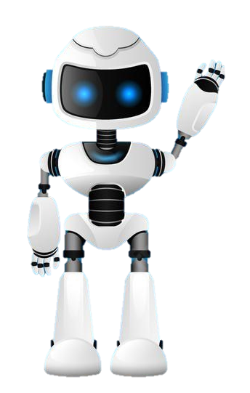

Learning Journal
Unit 2
Programming

Slide 2

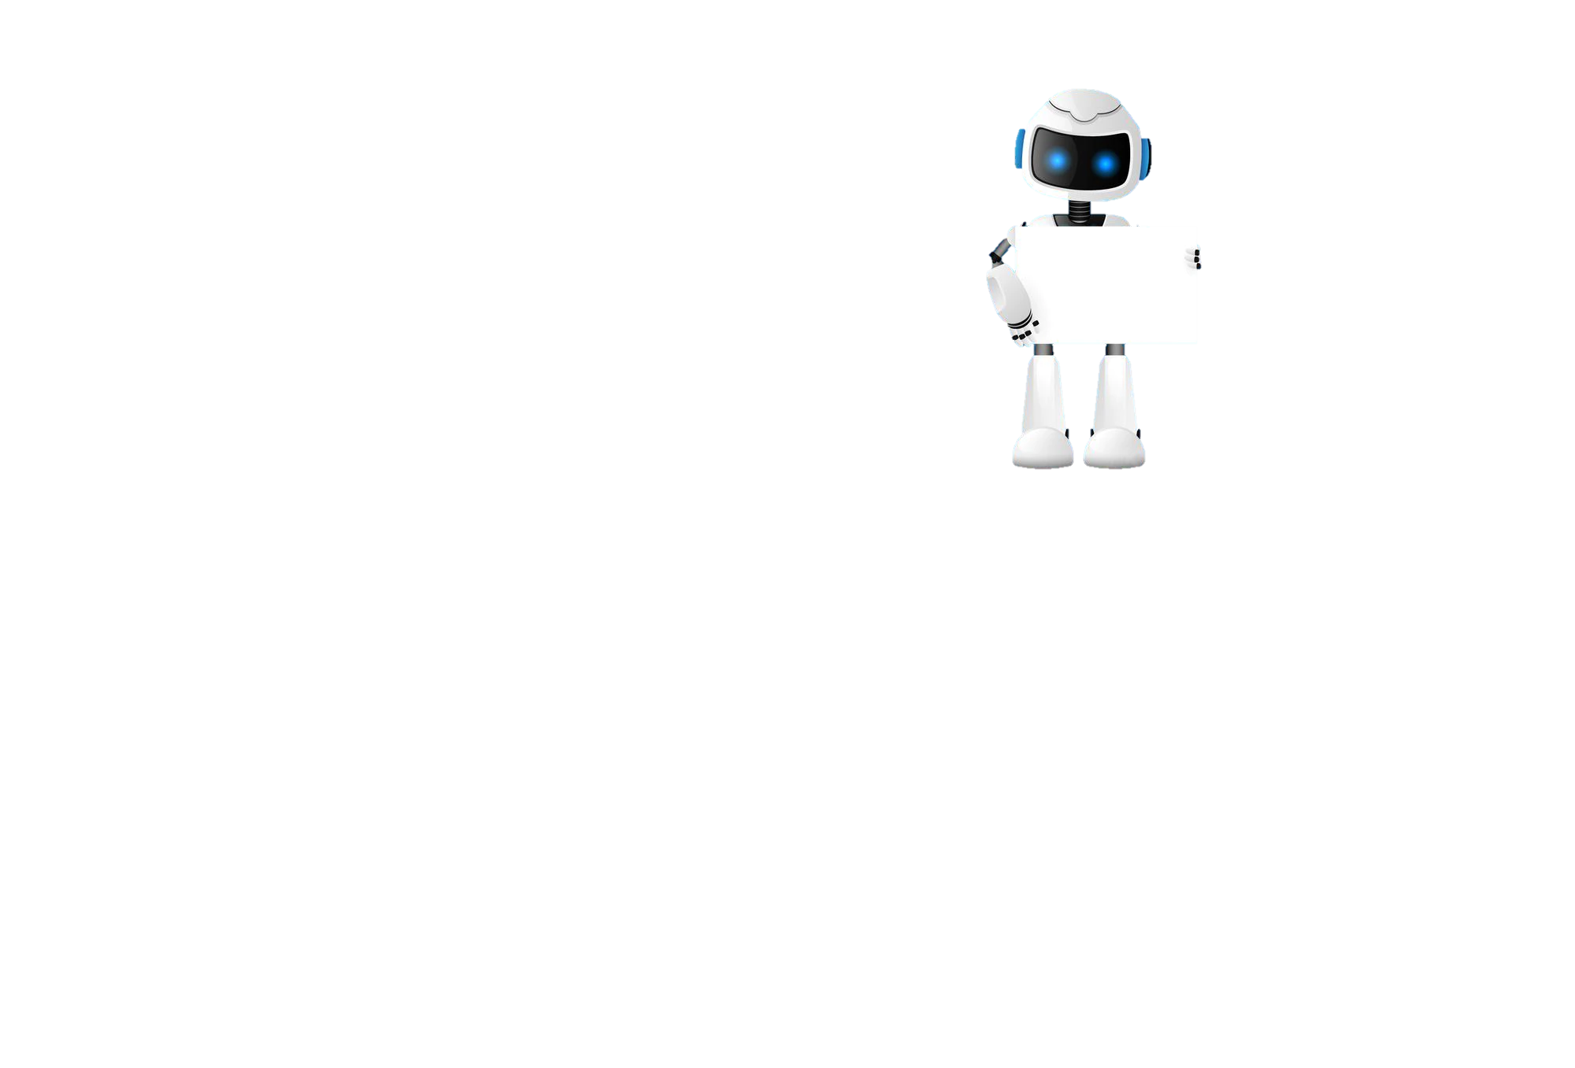

Task 1 – Getting Started
Learning Objectives
Start
I can use Iteration in a computer program
I can use condition controlled loops in python
Python
In your own words write down what an if statement is and give an example of how you would use one in python.
Learn

Slide 3

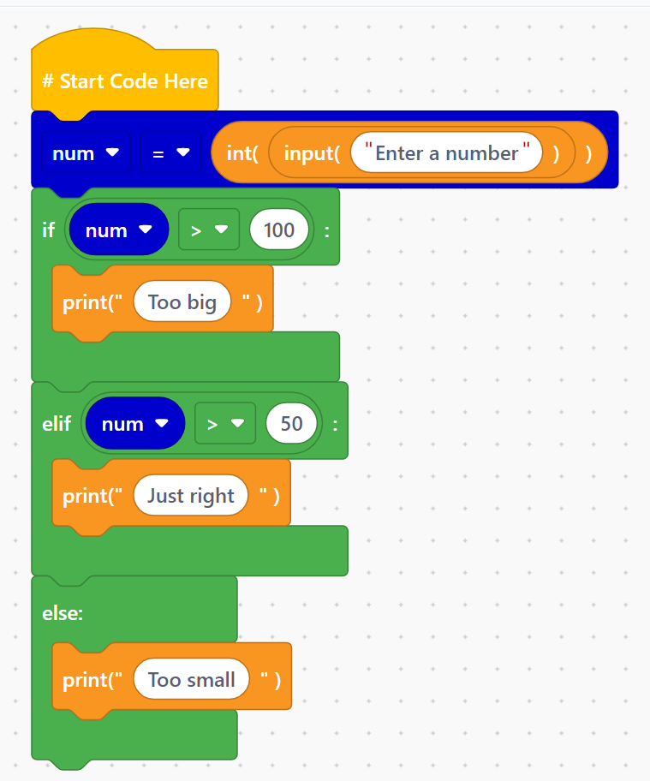
I can use Edublocks to help me with coding syntax
Task 2 – Edublocks

Slide 4
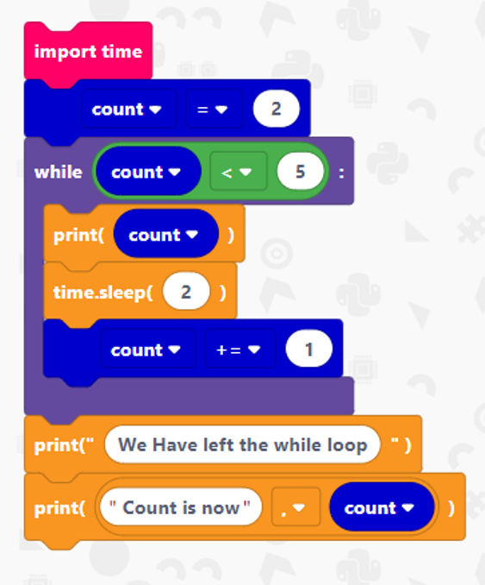
I can use Edublocks to help me with coding syntax
Task 3 – Edublocks While Loops

Slide 5
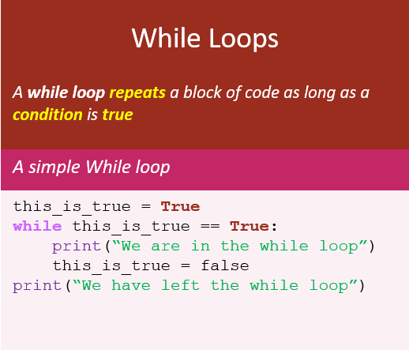
I can use Condition Controlled Loop in python
Task 4 – Condition controlled loops
Put a screen capture of your python code and output here

Slide 6
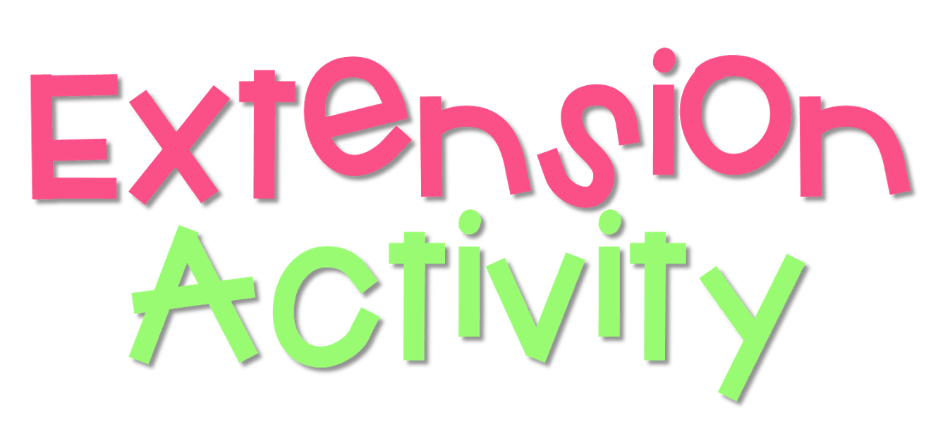
I can use and improve or fix while loops
Task 4 – Extension
Put a screen capture of your python code and output here

Slide 7

Task 5 – Lesson Review
Learning Objectives
Complete
How did you do?
Select the appropriate circle. Then go to shape format in the menu and colour it in.
I can use Iteration in a computer program
I can use condition controlled loops in python
Reflect
Write what you have learned today in the box below and anything you are still unsure of.

Slide 8


Homework
Get up to date with any work you have missed or not completed in this PowerPoint or in your Student Workbook.
Fill in the notes section with anything you think is important that you need to remember.

Slide 9
Notes
Put any notes you make in the box below

