Slide 1



Learning Journal
Unit 2
Programming

Slide 2



Task 1 – Getting Started
Learning Objective 2
Start
I can use a one dimensional list as a data structure
Unit 3.2
Programming
I can get information from a one dimensional list
I can modify the values in a one dimensional list
Recap
Explain the difference between an array and a list.

Slide 3
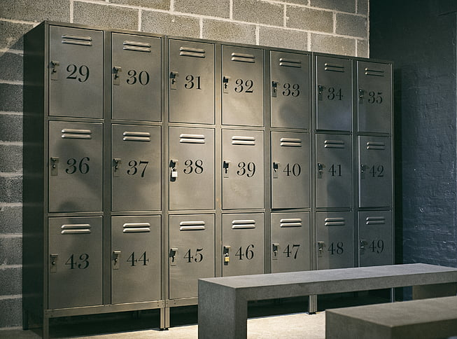
What is an array in computer science and how is it different from a list in terms of size?
DEXAN
Describe
Explain
Analyse
Task 2 – Data Structures
An array is a data structure in computer science that stores a collection of items, similar to a list. However, an array has a fixed size which means that once it is created, the number of elements it can hold is fixed and cannot be changed. This means that once all the "lockers" are full, you can't add more items to it, but you can change the item stored in any locker.
What is a list in computer science and how is it different from an array in terms of adding or removing items?
A list is a data structure in computer science that also stores a collection of items, similar to an array. Unlike an array, a list can be resized, meaning you can add or remove items from it as needed. Lists are useful when you don't know the number of items you are going to store or when you need to insert or delete items often.

Slide 4
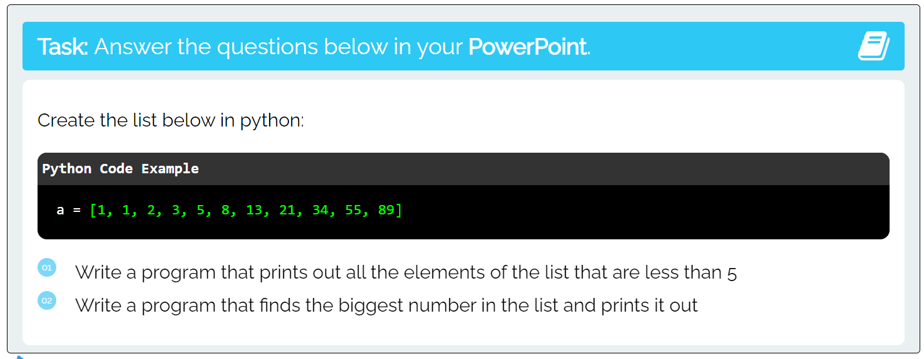
I can get information from a one dimensional list
Task 2 – Using data structures
Put a screen capture of your python code and output below

Slide 5
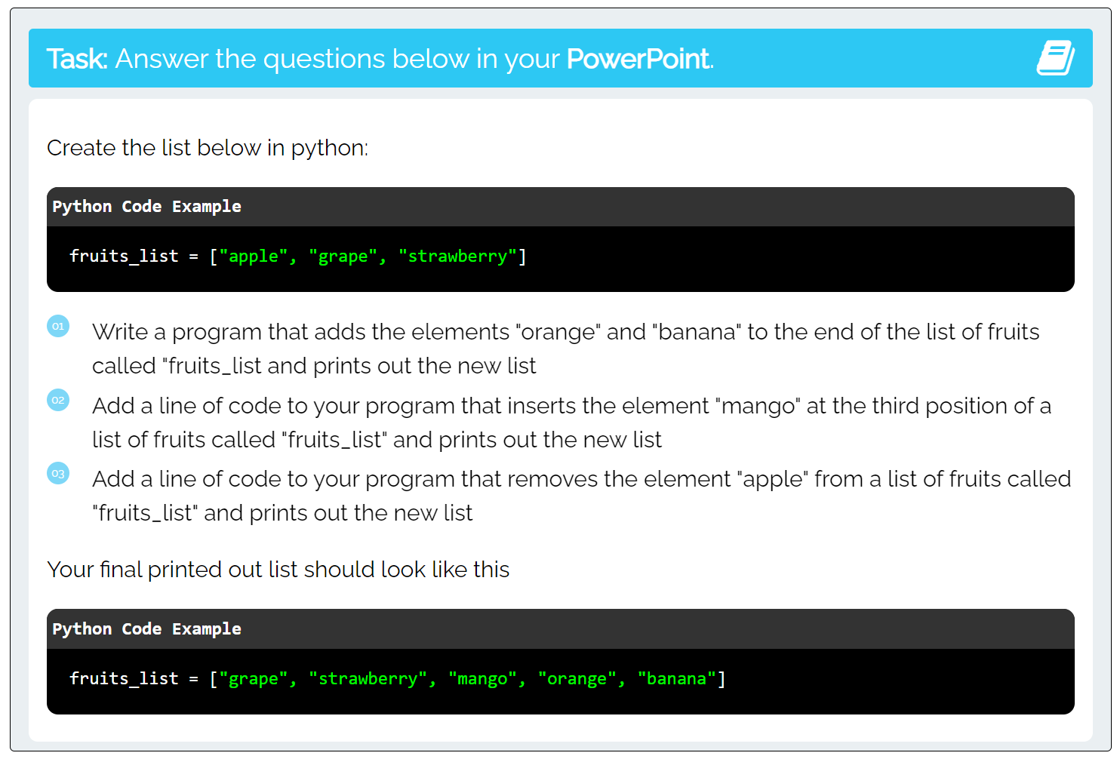
I can modify the values in a one dimensional list
Task 3 – Changing data structures
Put a screen capture of your python code and output below

Slide 6

Don’t forget to also change the colour of your learning Objective on LEARNITWITHMRC.
Learning Objectives
How did you do?
Complete
I can use a one dimensional list as a data structure
I can get information from a one dimensional list
Reflect
I can modify the values in a one dimensional list
Write what you have learned today in the box below and anything you are still unsure of.

Slide 7


Homework
Get up to date with any work you have missed or not completed in this PowerPoint or in your Student Workbook.
Fill in the notes section with anything you think is important that you need to remember.

Slide 8
Notes
Put any notes you make in the box below

