Slide 1

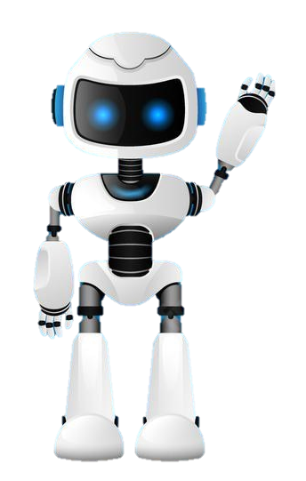

Learning Journal
Unit 2
Programming

Slide 2


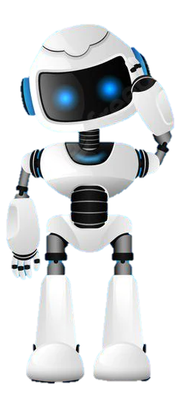
Task 1 – Getting Started
Learning Objective 2
Start
I can describe the structured(modular) approach to programming
Unit 3.2
Programming
I can understand what modularity is in a computer program
I can explain the advantages of the structured approach
Recap
Explain how I could convert a character to a number and then back again to a character in python.

Slide 3


I can describe the structured approach to programming
Task 2 – The Structured Approach
Watch the video and write your notes below

Slide 4
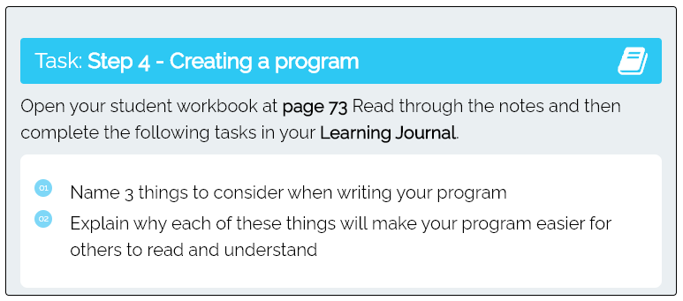
I can explain the advantages of the structured approach
Task 5 – Creating a program
Put your answers in the box below

Slide 5

Don’t forget to also change the colour of your learning Objective on LEARNITWITHMRC.
Learning Objectives
How did you do?
Complete
I can describe the structured(modular) approach to programming
I can understand what modularity is in a computer program
Reflect
I can explain the advantages of the structured approach
Write what you have learned today in the box below and anything you are still unsure of.

Slide 6


Homework
Get up to date with any work you have missed or not completed in this PowerPoint or in your Student Workbook.
Fill in the notes section with anything you think is important that you need to remember.

Slide 7
Notes
Put any notes you make in the box below

