Slide 1



Learning Journal
Unit 2
Programming

Slide 2



Task 1 – Getting Started
Learning Objective 2
Start
I can use selection in python with IF statements
Unit 3.2
Programming
I can use selection in python with IF elif, else statements
I can understand and use conditional statements correctly
Recap
Explain what a variable is and why they are used, give examples.

Slide 3
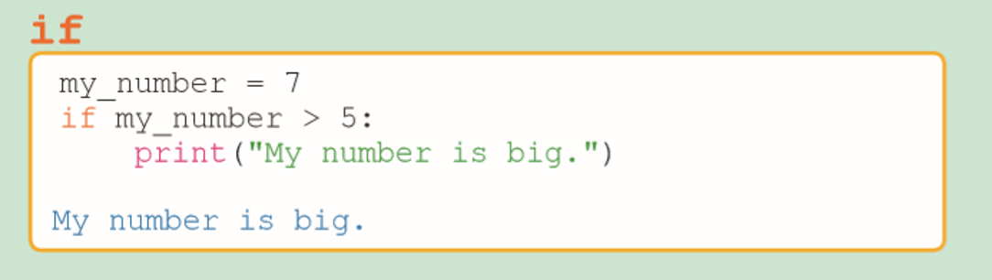
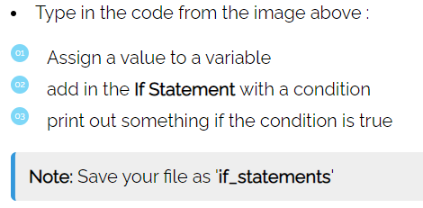
I can use selection in python with IF statements
Task 2 – What if?
Put a screen capture of your python code and output here

Slide 4



I can use selection in python with IF statements
Task 2 – What if?
Put a screen capture of your python code and output here

Slide 5
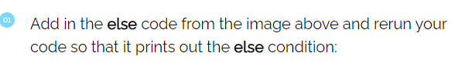
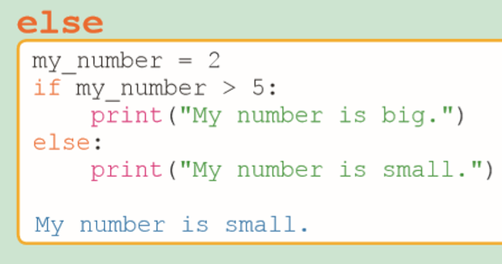
I can use selection in python with IF else statements
Task 3 – What else?

Slide 6

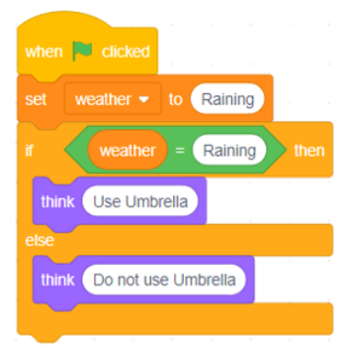
I can use selection in python with IF Else statements
Task 3 – What else?
Put a screen capture of your python code and output here

Slide 7

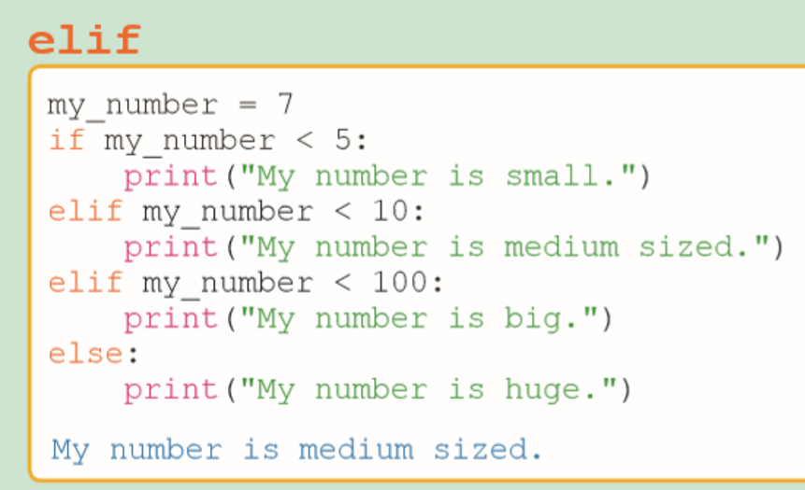
I can use selection in python with IF else elif statements
Task 3 – What else?

Slide 8

Don’t forget to also change the colour of your learning Objective on LEARNITWITHMRC.
Learning Objectives
How did you do?
Complete
I can use selection in python with IF statements
I can use selection in python with IF elif, else statements
Reflect
I can understand and use conditional statements correctly
Write what you have learned today in the box below and anything you are still unsure of.

Slide 9


Homework
Get up to date with any work you have missed or not completed in this PowerPoint or in your Student Workbook.
Fill in the notes section with anything you think is important that you need to remember.

Slide 10
Notes
Put any notes you make in the box below

