Slide 1

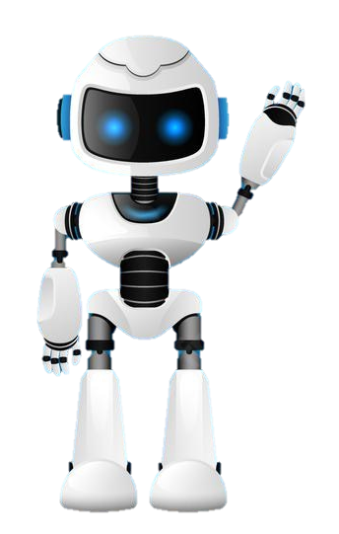

Learning Journal
Unit 2
Programming

Slide 2

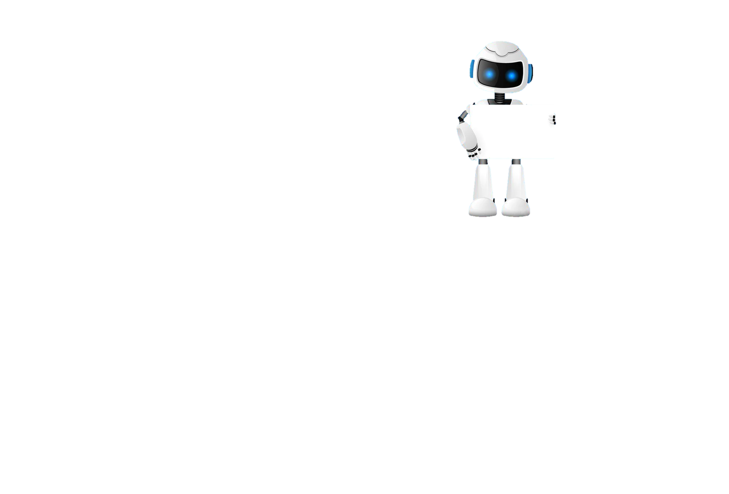
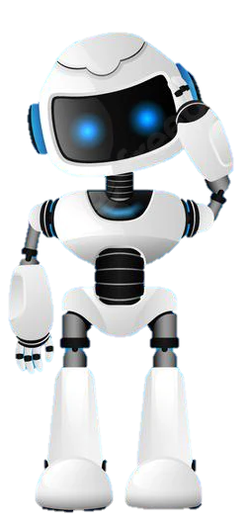
Task 1 – Getting Started
Learning Objective 2
Start
I can understand the concept of a string as a data type
Unit 3.2
Programming
I can find the length of a string and use index values to find the position of characters in a string
I can convert a string to a character code and visa versa
Recap
Explain how a string could also be classed as a data structure as well as a data type

Slide 3
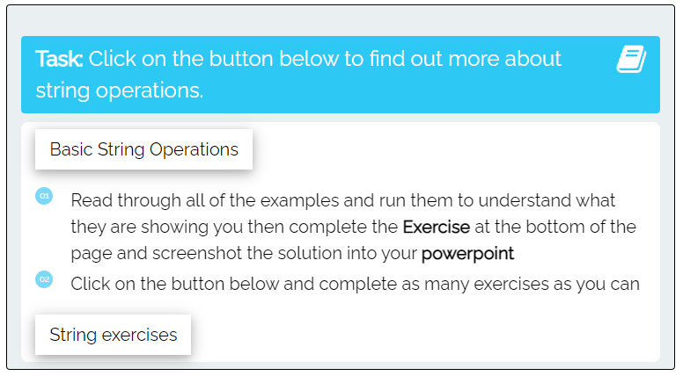
I can manipulate a string using index values
Task 2 – String Manipulation
Put a screen capture of your python code and output below

Slide 4
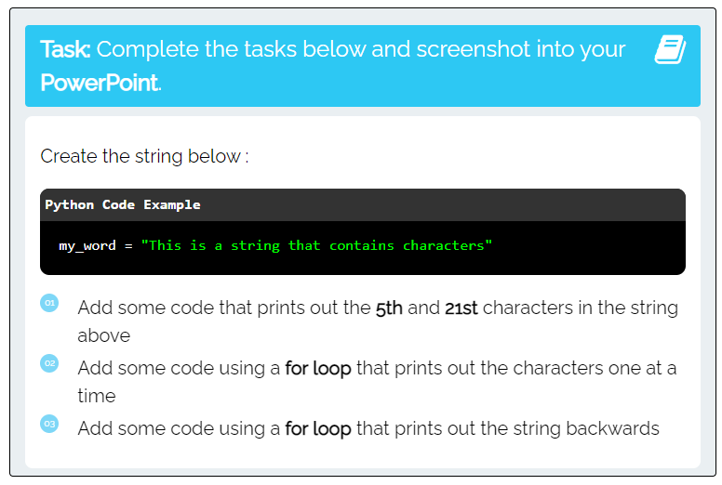
I can create and manipulate a simple string
Task 3 – Basic string operations
Put a screen capture of your python code and output below

Slide 5
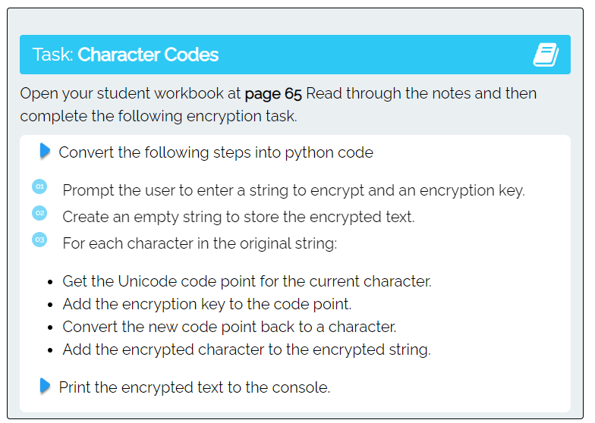
I can convert a string to a character code and visa versa
Task 5 – Encryption
Put a screen capture of your python code and output below

Slide 6

Don’t forget to also change the colour of your learning Objective on LEARNITWITHMRC.
Learning Objectives
How did you do?
Complete
I can understand the concept of a string as a data type
I can find the length of a string and use index values to find the position of characters in a string
Reflect
I can convert a string to a character code and visa versa
Write what you have learned today in the box below and anything you are still unsure of.

Slide 7


Homework
Get up to date with any work you have missed or not completed in this PowerPoint or in your Student Workbook.
Fill in the notes section with anything you think is important that you need to remember.

Slide 8
Notes
Put any notes you make in the box below

