Slide 1

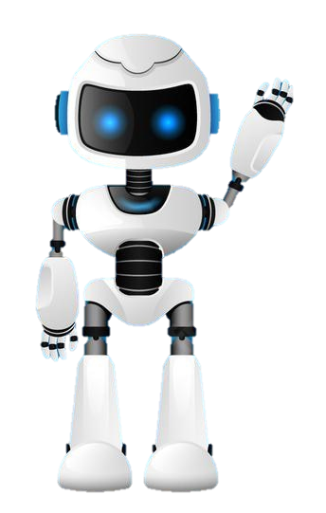
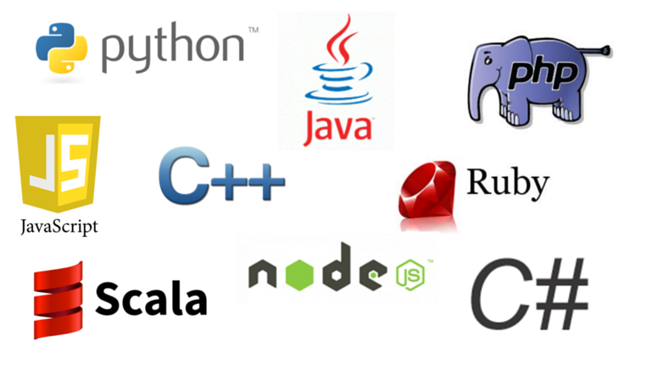
Learning Journal
Unit 2
Programming

Slide 2

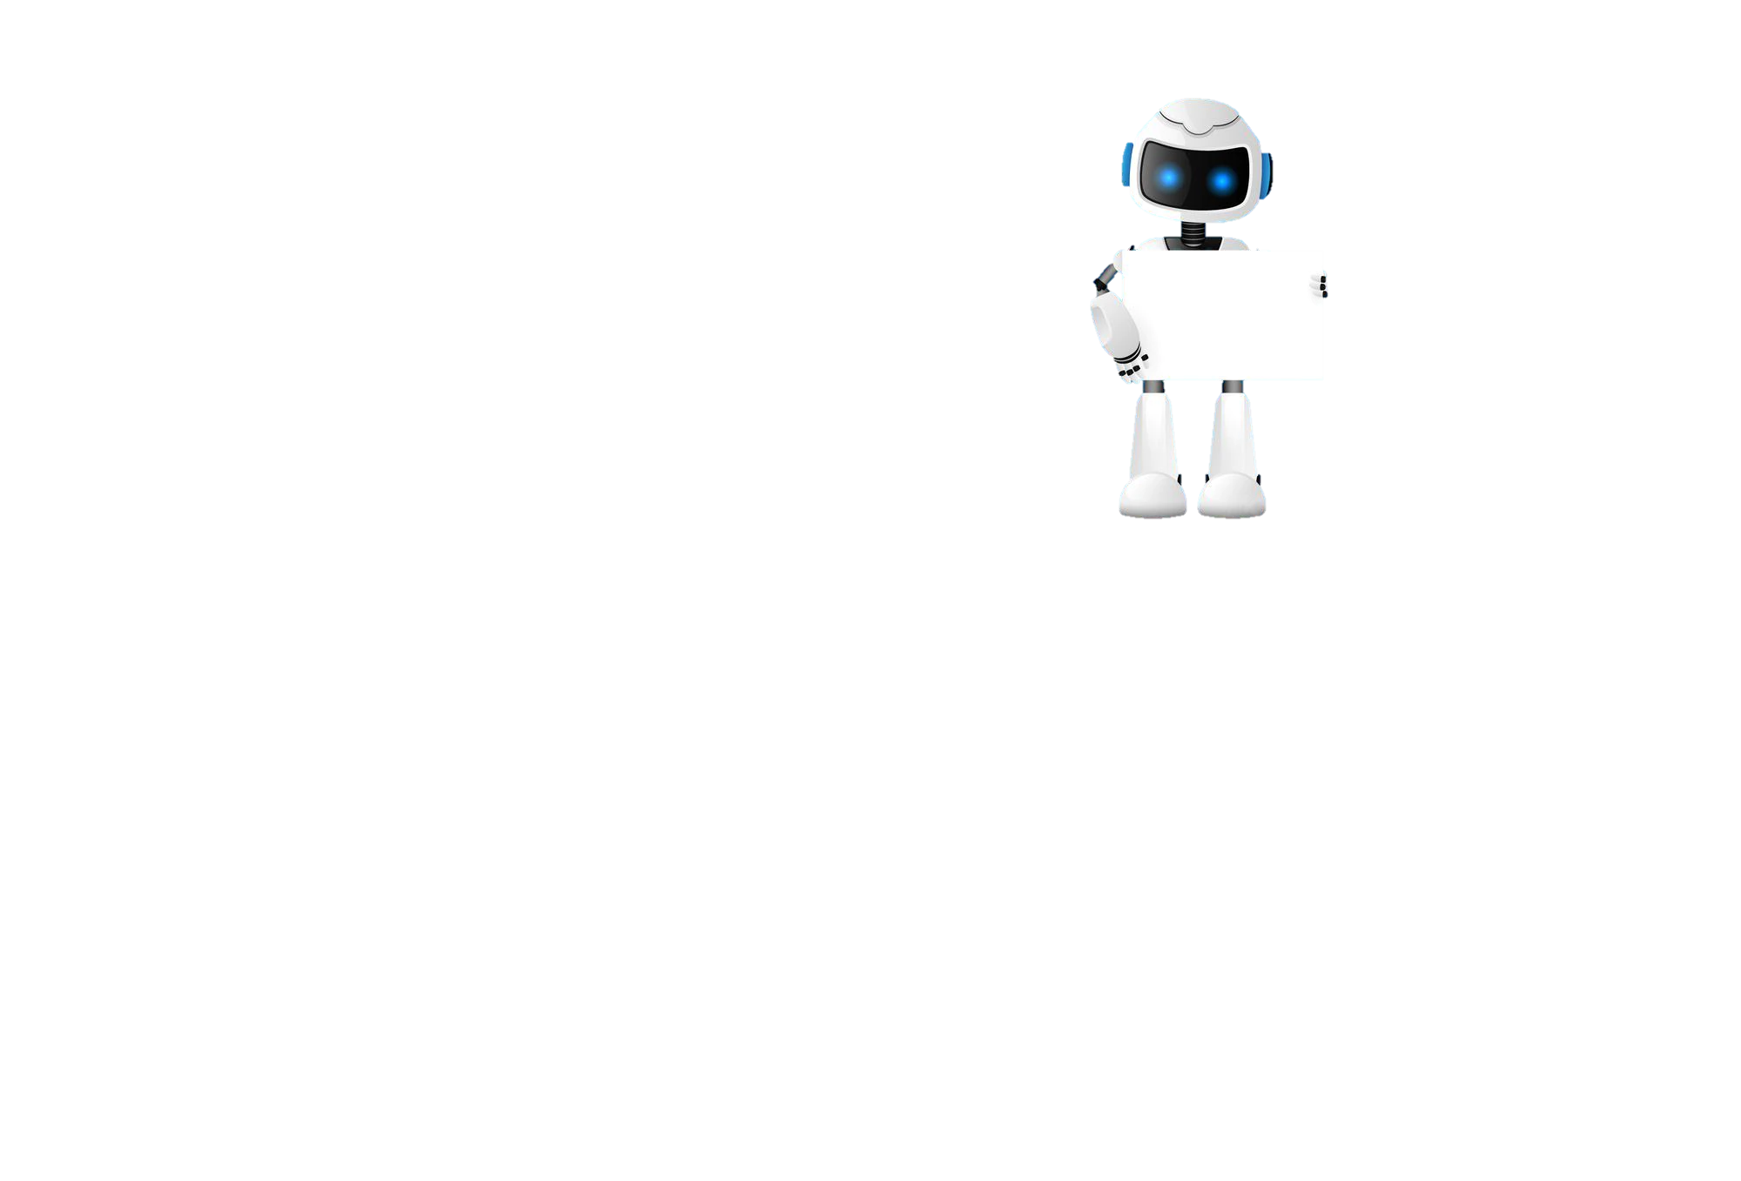
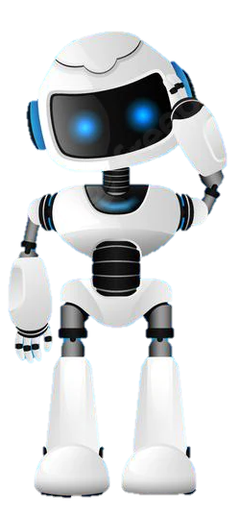
Task 1 – Getting Started
Learning Objective 2
Start
I can understand the concept of a subroutine
Unit 3.2
Programming
I can use and explain the advantages of using subroutines in programs
I can describe and use parameters to pass data correctly
Recap
Explain what a nesting is and give an example.

Slide 3
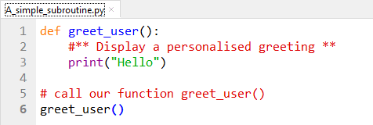
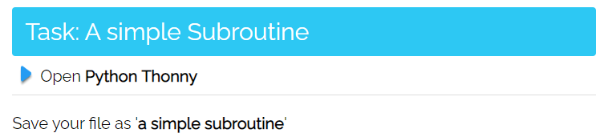
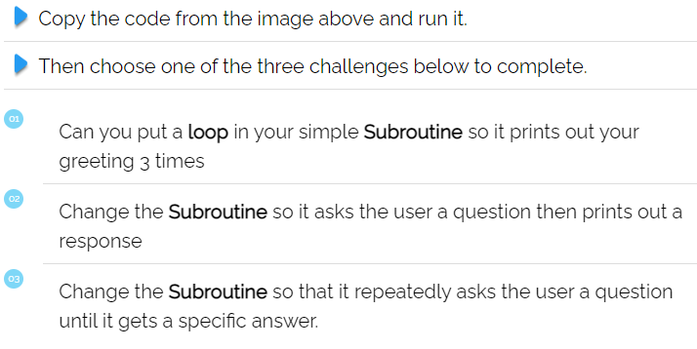
I can create a simple subroutine
Task 2 – Introducing Subroutines
Subroutines
Subroutines are named blocks of code, designed to do one specific job. We can reuse the code within the Subroutine by calling them. You call a subroutine by using its name including the brackets.
Put a screen capture of your python code and output below
A simple subroutine

Slide 4
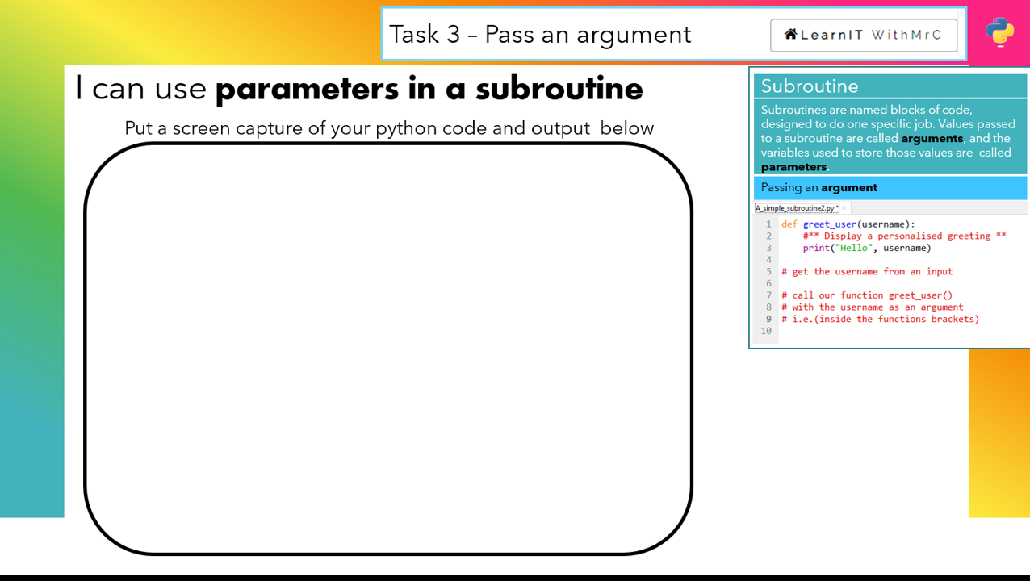
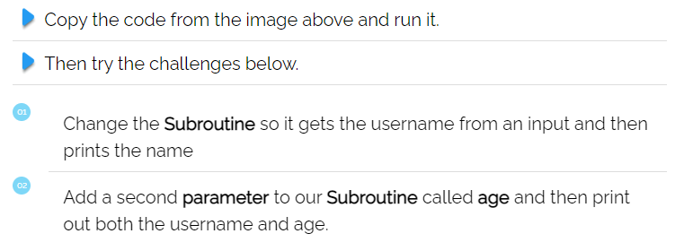
Put your answer in here

Slide 5
I can describe what a subroutine is
Task 4 – Recap What are procedures?
DEXAN
Describe
Explain
Analyse
I can explain the advantages of using a subroutine

Slide 6
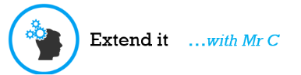
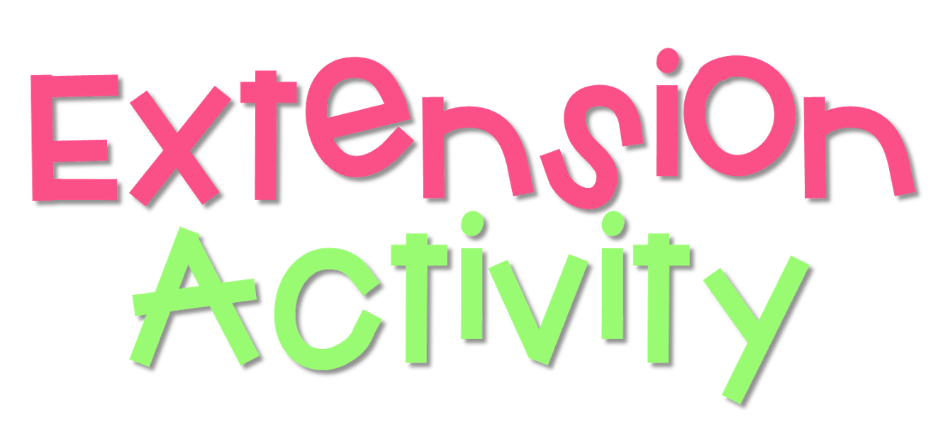
I can describe and use parameters to pass data correctly
Task 4 – Extension
Write an algorithm in pseudocode that:
Asks a USER to input two numbers
Passes those numbers to a subroutine called add
Displays the sum of those two numbers to the screen
Put your answer in here

Slide 7

Don’t forget to also change the colour of your learning Objective on LEARNITWITHMRC.
Learning Objectives
How did you do?
Complete
I can understand the concept of a subroutine
I can use and explain the advantages of using subroutines in programs
Reflect
I can describe and use parameters to pass data correctly
Write what you have learned today in the box below and anything you are still unsure of.

Slide 8


Homework
Get up to date with any work you have missed or not completed in this PowerPoint or in your Student Workbook.
Fill in the notes section with anything you think is important that you need to remember.

Slide 9
Notes
Put any notes you make in the box below

