Slide 1

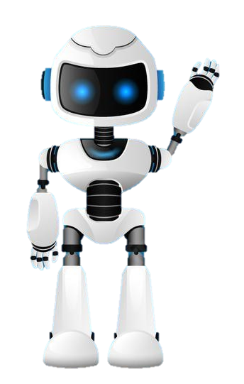

Learning Journal
Unit 2
Programming

Slide 2

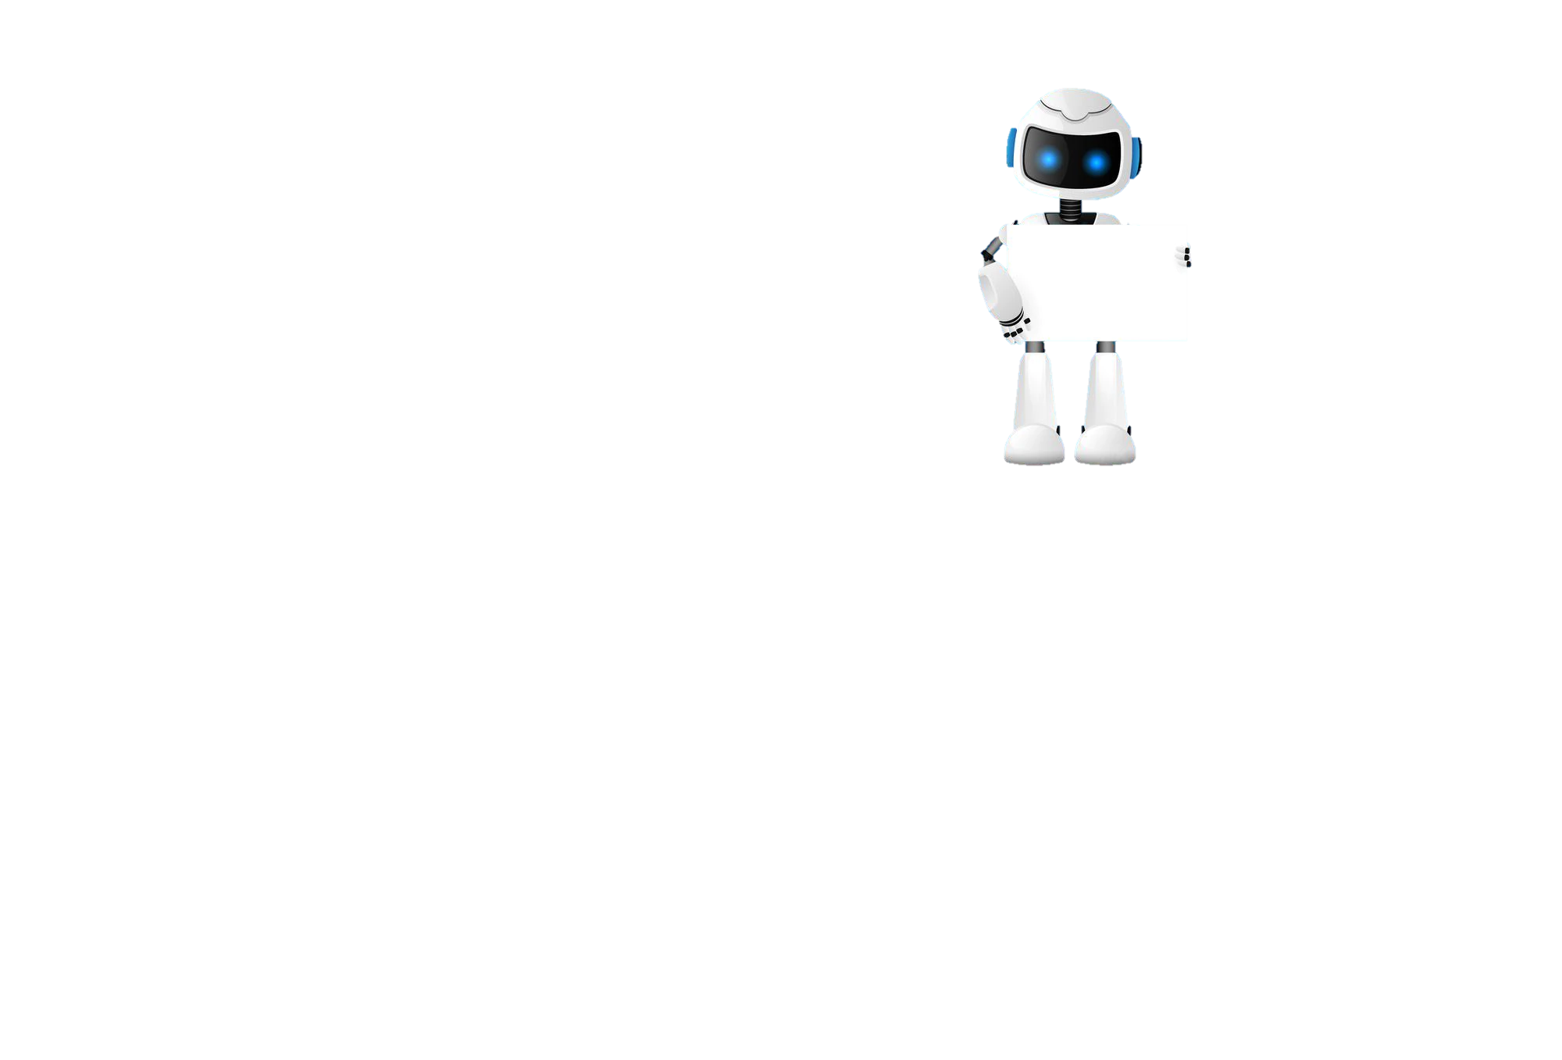
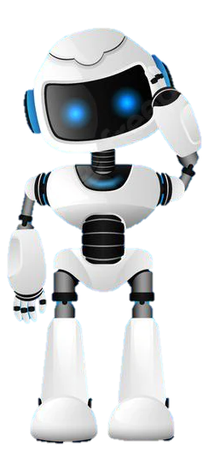
Task 1 – Getting Started
Learning Objective 2
Start
I can use a subroutine to return values to the calling routine
Unit 3.2
Programming
I can use and explain the differences between Local and Global variables
I can explain why it is good practice to use local variables
Recap
Explain what a subroutine is and give a simple example.

Slide 3
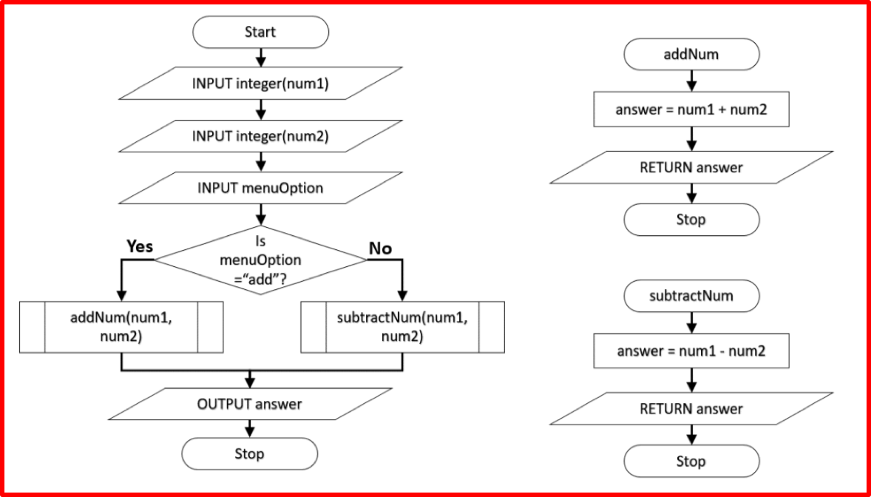
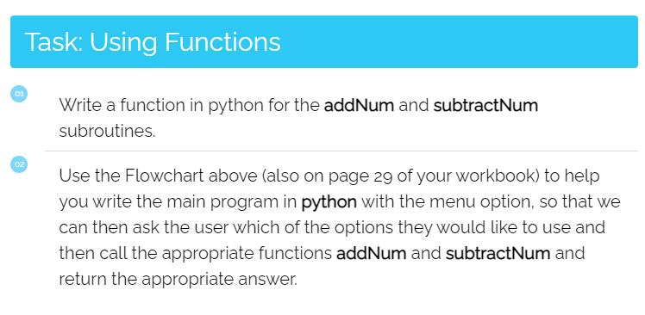
I can write a simple subroutine that returns a value
Task 2 – Returning Values
Put a screen capture of your python code and output below

Slide 4
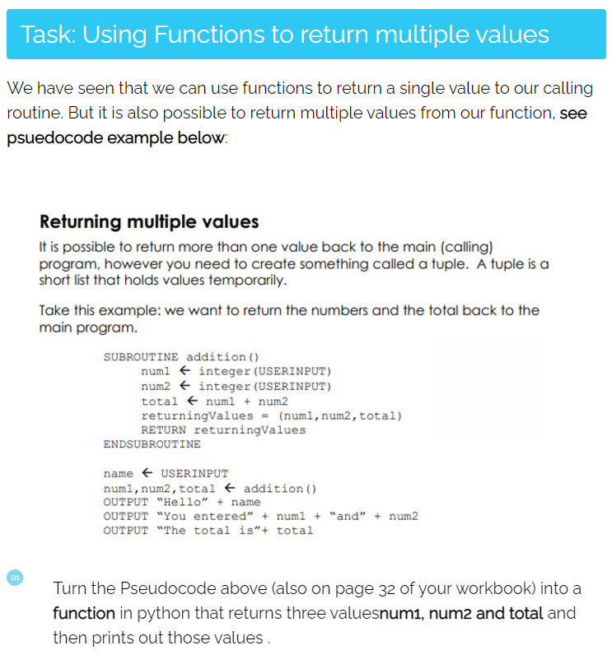
I can write a subroutine that returns multiple values
Task 3 – Returning Multiple Values
Put a screen capture of your python code and output below

Slide 5
I can describe what a local variable is
Task 4 – Local and global variables?
DEXAN
Describe
Explain
Analyse
I can explain the difference between a Local and Global variable and give an example

Slide 6

Don’t forget to also change the colour of your learning Objective on LEARNITWITHMRC.
Learning Objectives
How did you do?
Complete
I can use a subroutine to return values to the calling routine
I can use and explain the differences between Local and Global variables
Reflect
I can explain why it is good practice to use local variables
Write what you have learned today in the box below and anything you are still unsure of.

Slide 7


Homework
Get up to date with any work you have missed or not completed in this PowerPoint or in your Student Workbook.
Fill in the notes section with anything you think is important that you need to remember.

Slide 8
Notes
Put any notes you make in the box below

