Slide 1



Learning Journal
Unit 2
Programming

Slide 2

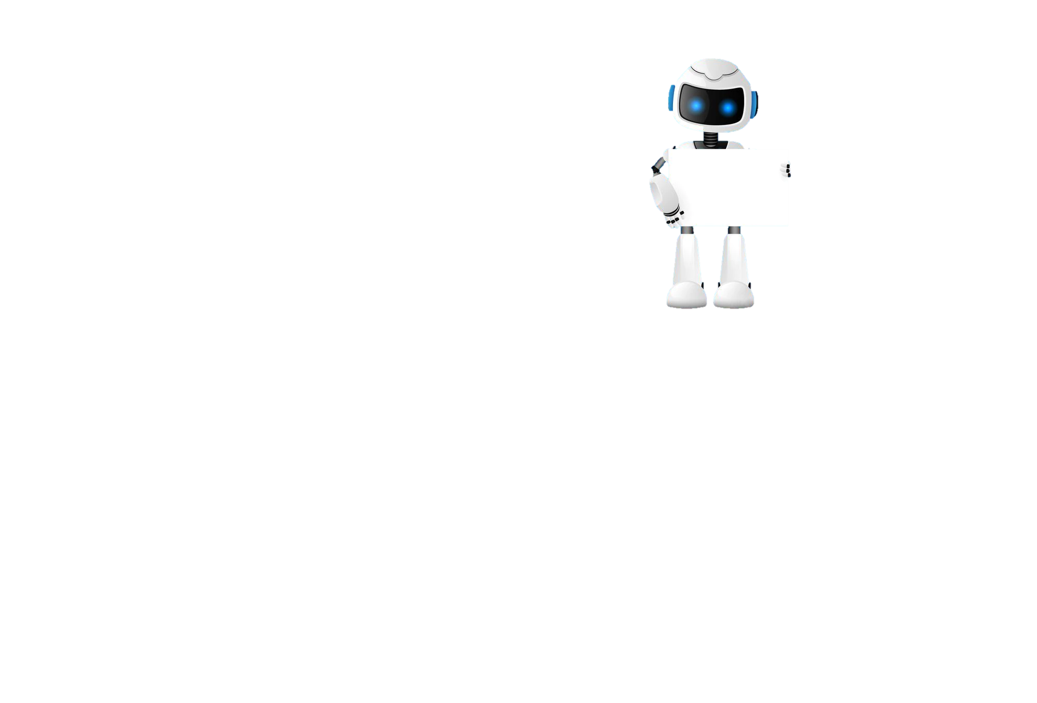

Task 1 – Getting Started
Learning Objective 2
Start
I can explain the three principles of Imperative languages
Unit 3.2
Programming
I can use variables and constants correctly in a computer program.
I can correctly assign values to variables and constants.
Recap
Explain what a Data Type is and give some examples.

Slide 3
I can name the three principles of imperative languages
Task 2 – Imperative Languages?
DEXAN
Describe
Explain
Analyse
I can give a definition of the three principles

Slide 4
I can describe a variable
Task 3 – Variables?
DEXAN
Describe
Explain
Analyse
I can describe a constant

Slide 5
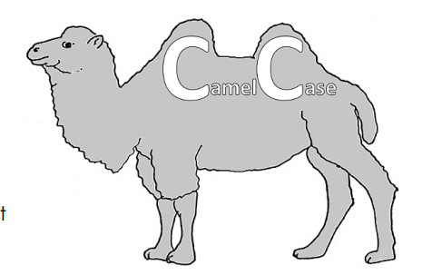
I can explain the naming conventions for constants and variables
Task 4 – Naming conventions
Use bullet points to list all the rules for naming variables
Put your answers in here

Slide 6

Don’t forget to also change the colour of your learning Objective on LEARNITWITHMRC.
Learning Objectives
How did you do?
Complete
I can explain the three principles of Imperative languages
I can use variables and constants correctly in a computer program.
Reflect
I can correctly assign values to variables and constants.
Write what you have learned today in the box below and anything you are still unsure of.

Slide 7


Homework
Get up to date with any work you have missed or not completed in this PowerPoint or in your Student Workbook.
Fill in the notes section with anything you think is important that you need to remember.

Slide 8
Notes
Put any notes you make in the box below

