Slide 1



Learning Journal
Unit 3
Data Representation

Slide 2
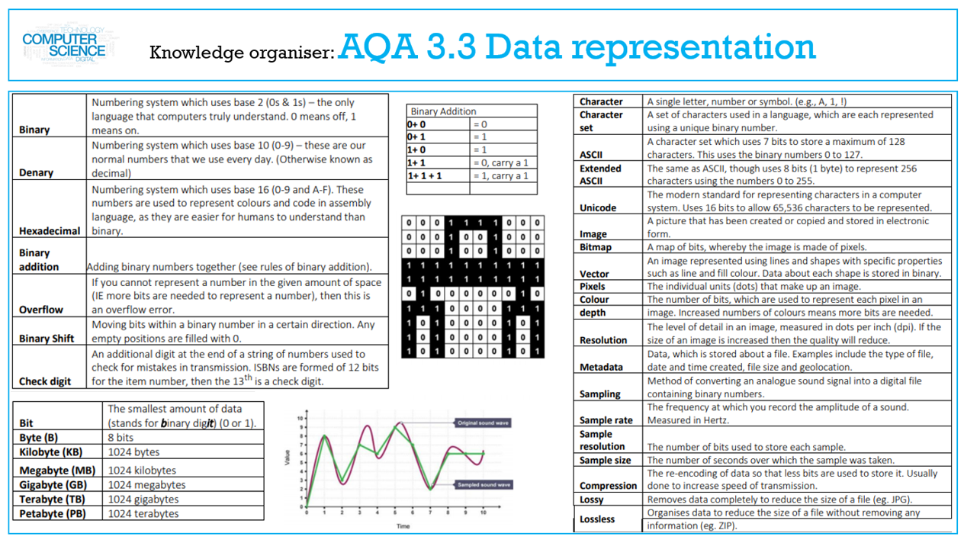

Slide 3
Number bases
I can understand decimal (base 10)
I can understand binary (base 2)
I can understand hexadecimal (base 16).
I can understand that computers use binary to represent all data and instructions.
I can explain why hexadecimal is often used in computer science.

Slide 4

Put the related Learning objective here
Task – Write the name of the Task in here
Put your answer or screenshot below

Slide 5


Don’t forget to change the colour of your learning Objective on LEARNITWITHMRC.
How did you do?
Write anything you have learned today in the box below and anything you are still unsure of.
Reflect

Slide 6

Notes
Put any notes you make in the box below

Slide 7
Converting between number bases
I can understand how binary can be used to represent whole numbers.
I can understand how hexadecimal can be used to represent whole numbers.
I can convert from binary to decimal.
I can convert from decimal to binary.
I can convert in both directions between binary and hexadecimal.
I can convert from hexadecimal to decimal.
I can convert from decimal to hexadecimal.

Slide 8
Put the related Learning objective here
Task – Write the name of the Task in here
Put your answer or screenshot below

Slide 9
Don’t forget to change the colour of your learning Objective on LEARNITWITHMRC.
How did you do?
Write anything you have learned today in the box below and anything you are still unsure of.
Reflect

Slide 10
Notes
Put any notes you make in the box below

Slide 11
Units of information
I can explain that that quantities of bytes can be described using prefixes.
I can explain that kilo, 1 KB is 1,000 bytes.
I can explain that mega, 1 MB is 1,000 kilobytes
I can explain that giga, 1 GB is 1,000 Megabytes
I can explain that tera, 1 TB is 1,000 Gigabytes.
I can compare quantities of bytes using the prefixes above

Slide 12
Put the related Learning objective here
Task – Write the name of the Task in here
Put your answer or screenshot below

Slide 13
Don’t forget to change the colour of your learning Objective on LEARNITWITHMRC.
How did you do?
Write anything you have learned today in the box below and anything you are still unsure of.
Reflect

Slide 14
Notes
Put any notes you make in the box below

Slide 15
Binary arithmetic
I can add together two binary numbers.
I can add together up to three binary numbers.
I can apply a binary shift to a binary number.
I can describe situations where binary shifts can be used.

Slide 16
Put the related Learning objective here
Task – Write the name of the Task in here
Put your answer or screenshot below

Slide 17
Don’t forget to change the colour of your learning Objective on LEARNITWITHMRC.
How did you do?
Write anything you have learned today in the box below and anything you are still unsure of.
Reflect

Slide 18
Notes
Put any notes you make in the box below

Slide 19
Character encoding
I can understand what a character set is.
I can describe the ASCII amd Unicode character encoding methods:
I can convert characters to character codes
I can convert character codes to characters.
I can understand that character codes are commonly grouped and run in sequence within encoding tables.
I can describe the purpose of Unicode and the advantages of Unicode over ASCII.
I can describe how Unicode uses the same codes as ASCII up to 127.

Slide 20
Put the related Learning objective here
Task – Write the name of the Task in here
Put your answer or screenshot below

Slide 21
Don’t forget to change the colour of your learning Objective on LEARNITWITHMRC.
How did you do?
Write anything you have learned today in the box below and anything you are still unsure of.
Reflect

Slide 22
Notes
Put any notes you make in the box below

Slide 23
Representing images
I can explain what a pixel is and how pixels relate to an image and the way images are displayed.
I can describe for bitmaps the image size in pixels.
I can describe for bitmaps the colour depth.
I can describe how the size of a bitmap image is measured in pixels (width x height)
I can describe how a bitmap represents an image using pixels and colour depth.
I can explain how the number of pixels and colour depth can affect the file size of a bitmap image.
I can calculate bitmap image file sizes based on the number of pixels and colour depth.
Convert binary data into a bitmap image.
I can convert a black and white image into binary data.

Slide 24
Put the related Learning objective here
Task – Write the name of the Task in here
Put your answer or screenshot below

Slide 25
Don’t forget to change the colour of your learning Objective on LEARNITWITHMRC.
How did you do?
Write anything you have learned today in the box below and anything you are still unsure of.
Reflect

Slide 26
Notes
Put any notes you make in the box below

Slide 27
Representing sound
I can understand that sound is analogue and that it must be converted to a digital form for storage and processing in a computer.
I can understand that analogue signals are sampled to create the digital version of sound.
I can describe the digital representation of sound in terms of sampling rate.
I can describe the digital representation of sound in terms of sample resolution.
I can calculate sound file sizes based on the sampling rate and the sample resolution.

Slide 28
Put the related Learning objective here
Task – Write the name of the Task in here
Put your answer or screenshot below

Slide 29
Don’t forget to change the colour of your learning Objective on LEARNITWITHMRC.
How did you do?
Write anything you have learned today in the box below and anything you are still unsure of.
Reflect

Slide 30
Notes
Put any notes you make in the box below

Slide 31
Data compression
I can explain what data compression is.
I can understand why data may be compressed and that there are different ways to compress data.
I can explain how data can be compressed using Huffman coding.
I can interpret Huffman trees.
I can calculate the number of bits required to store a piece of data compressed using Huffman coding.
I can calculate the number of bits required to store a piece of uncompressed data in ASCII.
I can explain how data can be compressed using run length encoding (RLE).

Slide 32
Put the related Learning objective here
Task – Write the name of the Task in here
Put your answer or screenshot below

Slide 33
Don’t forget to change the colour of your learning Objective on LEARNITWITHMRC.
How did you do?
Write anything you have learned today in the box below and anything you are still unsure of.
Reflect

Slide 34
Notes
Put any notes you make in the box below

Slide 35

Homework
Get up to date with any work you have missed or not completed in this PowerPoint or in your Student Workbook.
Fill in the notes section with anything you think is important that you need to remember.

