Slide 1


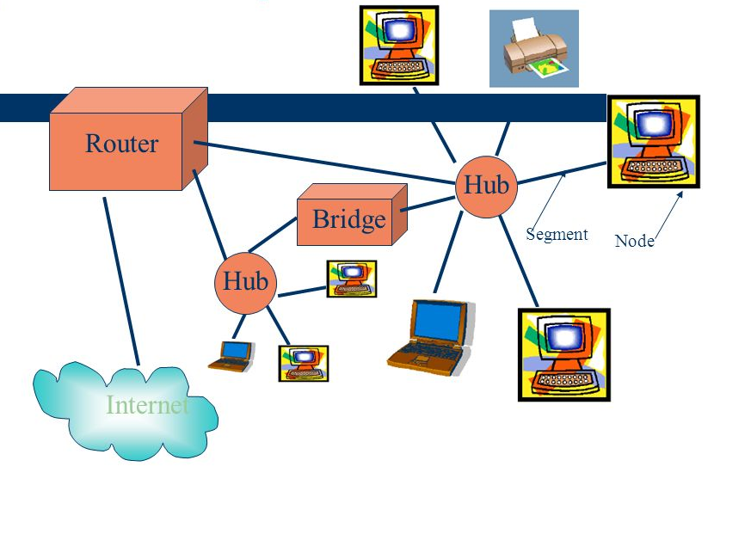
Learning Journal
Unit 5
Computer Networks

Slide 2
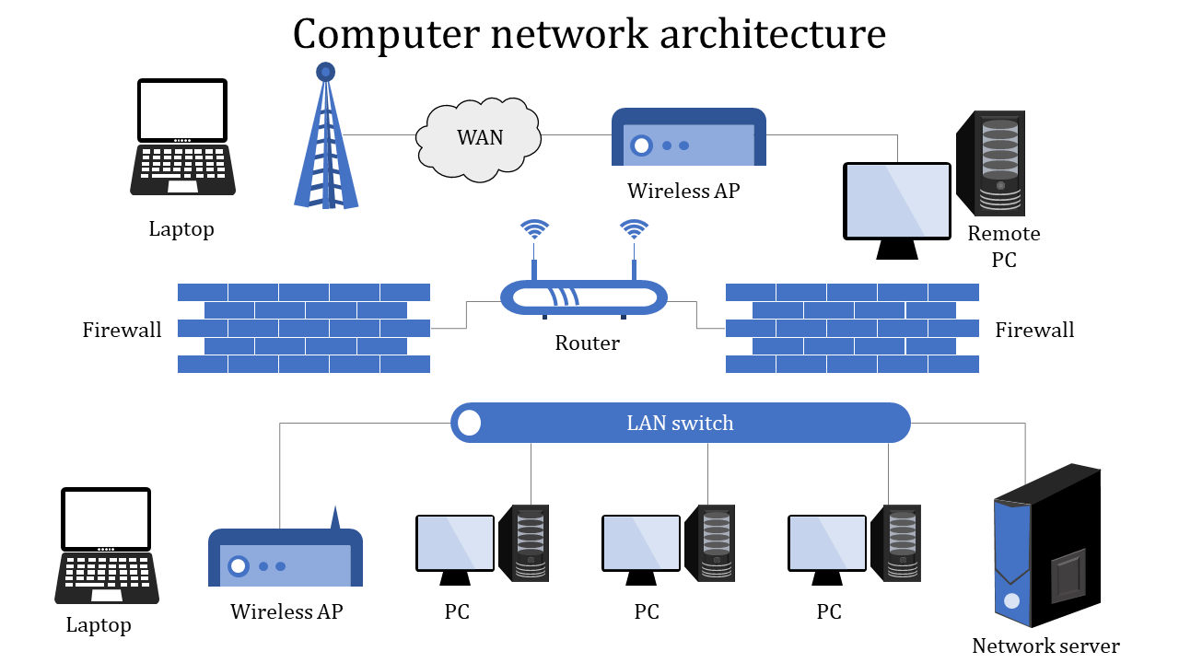

Slide 3
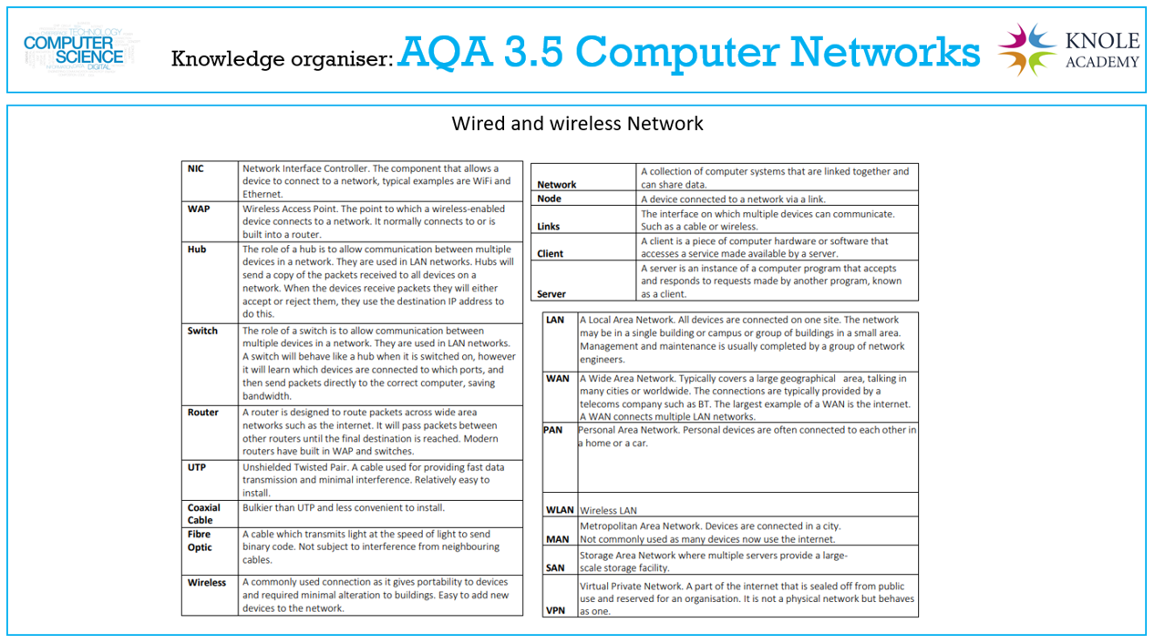

Slide 4
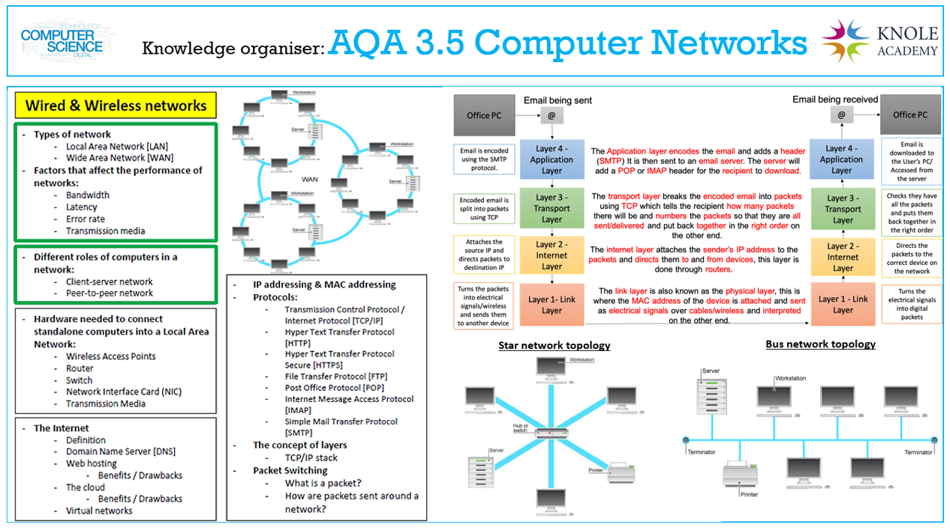

Slide 5
What is a computer network
I can define what a computer Network is
I can discuss the advantages and disadvantages of computer networks

Slide 6

Put the related Learning objective here
Task – Write the name of the Task in here
Put your answer or screenshot below

Slide 7


Don’t forget to change the colour of your learning Objective on LEARNITWITHMRC.
How did you do?
Write anything you have learned today in the box below and anything you are still unsure of.
Reflect

Slide 8

Notes
Put any notes you make in the box below

Slide 9
Types of Computer Networks
I can describe what a Personal Area Network (PAN) is
I can describe what a Local Area Network (LAN) is
I can describe what a Wide Area Network (WAN) is

Slide 10
Put the related Learning objective here
Task – Write the name of the Task in here
Put your answer or screenshot below

Slide 11
Don’t forget to change the colour of your learning Objective on LEARNITWITHMRC.
How did you do?
Write anything you have learned today in the box below and anything you are still unsure of.
Reflect

Slide 12
Notes
Put any notes you make in the box below

Slide 13
Wired and Wireless Networks
I can explain what is meant by a wired or wireless network
I can discuss the advantages and disadvantages of wireless networks as opposed to wired networks

Slide 14
Put the related Learning objective here
Task – Write the name of the Task in here
Put your answer or screenshot below

Slide 15
Don’t forget to change the colour of your learning Objective on LEARNITWITHMRC.
How did you do?
Write anything you have learned today in the box below and anything you are still unsure of.
Reflect

Slide 16
Notes
Put any notes you make in the box below

Slide 17
Network Topologies
I can describe the star LAN topology
I can describe the bus LAN topology

Slide 18
Put the related Learning objective here
Task – Write the name of the Task in here
Put your answer or screenshot below

Slide 19
Don’t forget to change the colour of your learning Objective on LEARNITWITHMRC.
How did you do?
Write anything you have learned today in the box below and anything you are still unsure of.
Reflect

Slide 20
Notes
Put any notes you make in the box below

Slide 21
Network Protocols
I can define the term network protocol
I can explain the purpose and use of the following common network protocols :
  Ethernet
  Wi-Fi
  TCP (Transmission Control Protocol)
  UDP (User Datagram Protocol)
  IP (Internet Protocol)
  HTTP (Hypertext Transfer Protocol)
  HTTPS (Hypertext Transfer Protocol Secure)
  FTP (File Transfer Protocol)
  email protocols:
  SMTP (Simple Mail Transfer Protocol)
  IMAP (Internet Message Access Protocol)

Slide 22
Put the related Learning objective here
Task – Write the name of the Task in here
Put your answer or screenshot below

Slide 23
Don’t forget to change the colour of your learning Objective on LEARNITWITHMRC.
How did you do?
Write anything you have learned today in the box below and anything you are still unsure of.
Reflect

Slide 24
Notes
Put any notes you make in the box below

Slide 25
Network Security
I can explain the need for, and importance of, network security.
I can Explain the following methods of network security:
    authentication
    encryption
    firewall
    MAC address filtering

Slide 26
Put the related Learning objective here
Task – Write the name of the Task in here
Put your answer or screenshot below

Slide 27
Don’t forget to change the colour of your learning Objective on LEARNITWITHMRC.
How did you do?
Write anything you have learned today in the box below and anything you are still unsure of.
Reflect

Slide 28
Notes
Put any notes you make in the box below

Slide 29
TCP/IP model
I can Describe the 4-layer TCP/IP model:
    application layer
    transport layer
    internet layer
    link layer
I can understand that the HTTP, HTTPS, SMTP, IMAP and FTP protocols operate at the application layer
I can understand that the TCP and UDP protocols operate at the transport layer
I can Understand that the IP protocol operates at the internet layer

Slide 30
Put the related Learning objective here
Task – Write the name of the Task in here
Put your answer or screenshot below

Slide 31
Don’t forget to change the colour of your learning Objective on LEARNITWITHMRC.
How did you do?
Write anything you have learned today in the box below and anything you are still unsure of.
Reflect

Slide 32
Notes
Put any notes you make in the box below

Slide 33

Homework
Get up to date with any work you have missed or not completed in this PowerPoint or in your Student Workbook.
Fill in the notes section with anything you think is important that you need to remember.

