Slide 1



Learning Journal
Unit 6
Cyber Security

Slide 2
Fundamentals of cyber security
By the end of this unit, you should be able to:
define the term cyber security and be able to describe the main purposes of cyber security.
Know that cyber security consists of the processes, practices and technologies designed to protect networks, computers, programs and data from attack, damage or unauthorised access.

Slide 3
Fundamentals of cyber security
By the end of this unit, you should be able to Understand and be able to explain the following cyber security threats:
social engineering techniques
malicious code (malware)
pharming
weak and default passwords
misconfigured access rights
removable media
unpatched and/or outdated software.

Slide 4
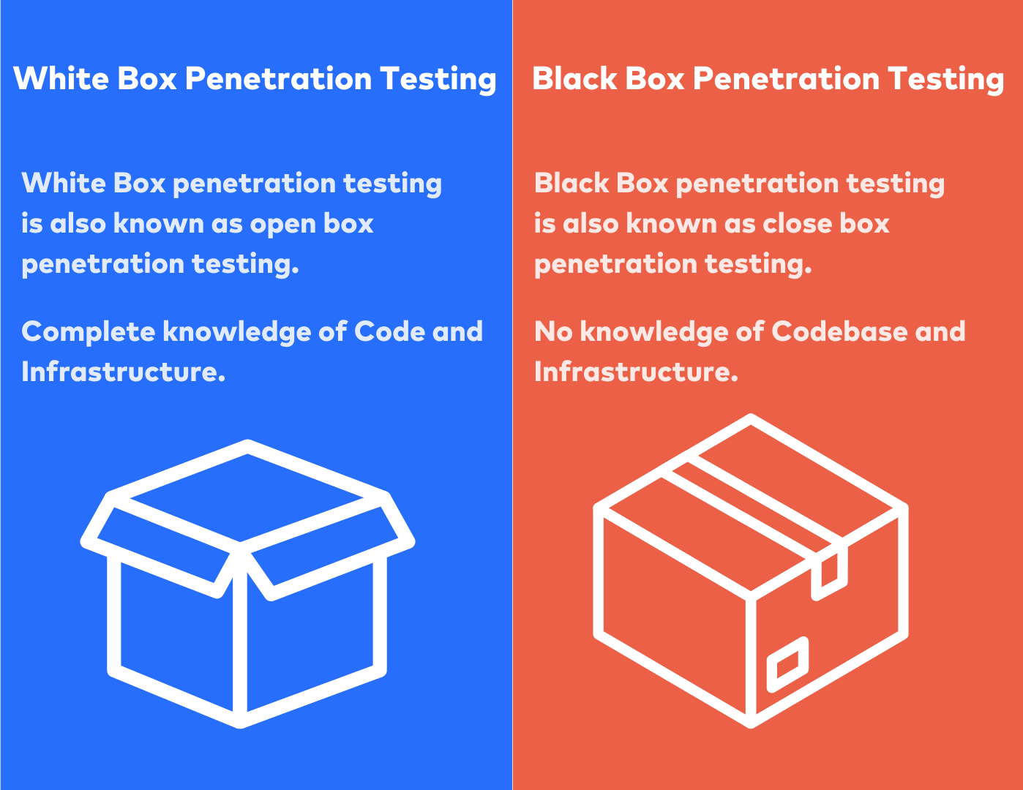
Fundamentals of cyber security
By the end of this unit, you should be able to Understand and be able to :
Explain what penetration testing is and what it is used for

Slide 5



Lesson 1 – Social Engineering
Learning Objective 2
Start
I can define the term cyber security and describe the main purposes of cyber security.
Unit 3.6
Cyber Security
Recap
Describe the term cyber security and describe the main purposes of cyber security

Slide 6
Put the related Learning objective here
Task – Write the name of the Task in here
Put your answer or screenshot below

Slide 7

Don’t forget to change the colour of your learning Objective on LEARNITWITHMRC.
How did you do?
Write anything you have learned today in the box below and anything you are still unsure of.
Reflect

Slide 8

Notes
Put any notes you make in the box below

Slide 9
Lesson 2 – Malicious code (malware)
Learning Objective 2
Start
I can define the term malware and how it can be protected against.
Unit 3.6
Cyber Security
Recap
Describe the terms computer virus, trojan, spyware.

Slide 10
Put the related Learning objective here
Task – Write the name of the Task in here
Put your answer or screenshot below

Slide 11
Don’t forget to change the colour of your learning Objective on LEARNITWITHMRC.
How did you do?
Write anything you have learned today in the box below and anything you are still unsure of.
Reflect

Slide 12
Notes
Put any notes you make in the box below

Slide 13
Lesson 3/4 – Methods to detect and prevent cyber security threat
Learning Objective 2
Start
I can Understand and be able to explain security measures to prevent cyber security threats
Unit 3.6
Cyber Security
Recap
Explain the term penetration testing.

Slide 14
Put the related Learning objective here
Task – Write the name of the Task in here
Put your answer or screenshot below

Slide 15
Don’t forget to change the colour of your learning Objective on LEARNITWITHMRC.
How did you do?
Write anything you have learned today in the box below and anything you are still unsure of.
Reflect

Slide 16
Notes
Put any notes you make in the box below

