Slide 1
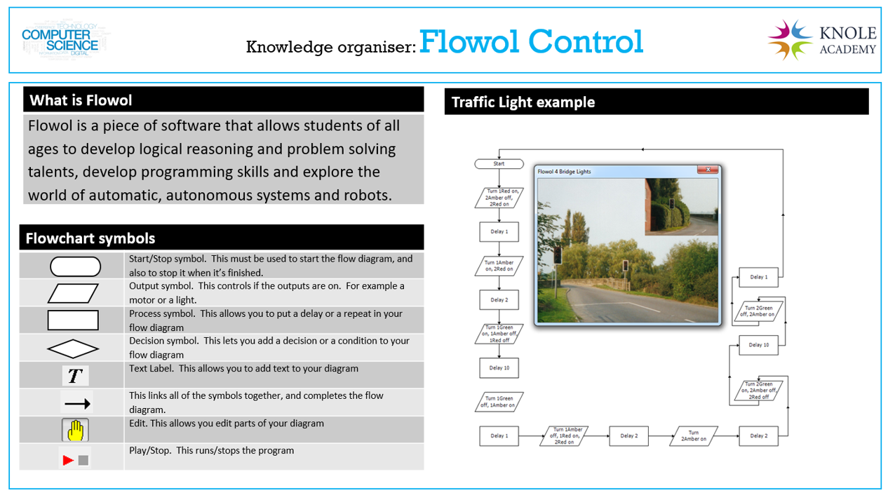
Put Your Name Here

Slide 2
Menu
Lesson 1

Slide 3
Lesson 1

