Slide 1

Pygame Assessment
Put your name here
Computer Science

Slide 2
Task 1
Code Template
# pygame template - LearnItWithMrC
import pygame # accesses pygame files
import sys # to communicate with windows
# game setup ################ only runs once
pygame.init() # starts the game engine
clock = pygame.time.Clock() # creates clock to limit frames per second
FPS = 60 # sets max speed of main loop
SCREENWIDTH = 640 # sets the width of the screen/window
SCREENHEIGHT = 480 # sets the height of the screen/window
screen = pygame.display.set_mode((SCREENWIDTH ,SCREENHEIGHT)) # creates window and game screen with twin value
# set variables for colors RGB (0-255)
white = (255, 255, 255)
black = (0, 0, 0)
red = (255, 0, 0)
yellow = (255, 255, 0)
green = (0, 255, 0)
##### Your Variables go here #################
##############################################
# game loop #################### runs 60 times a second!
while True: # game loop - note: everything in the mainloop is indented one tab
for event in pygame.event.get(): # get user interaction events
if event.type == pygame.QUIT: # tests if window's X (close) has been clicked
pygame.quit() # stops the game engine
sys.exit() # close operating system window
# your code starts here ##############################
# your code ends here ###############################
pygame.display.flip() # updates the entire screen
clock.tick(FPS) # limits game to frame per second, FPS value
# out of game loop ###############
Use this code as your for Pygame assessment
Copy this template code into Thonny then run it to make sure it works before you start to the assessment

Slide 3
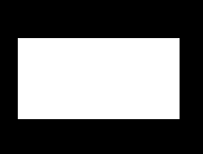


Question 1
Pygame Shapes
Draw a white rectangle
Marks(1)
Draw a red circle
Marks(1)
Draw the Japanese
Flag
Marks(4)
Extra mark for using variables
Total makes available 5

Slide 4
Put your code here

Slide 5
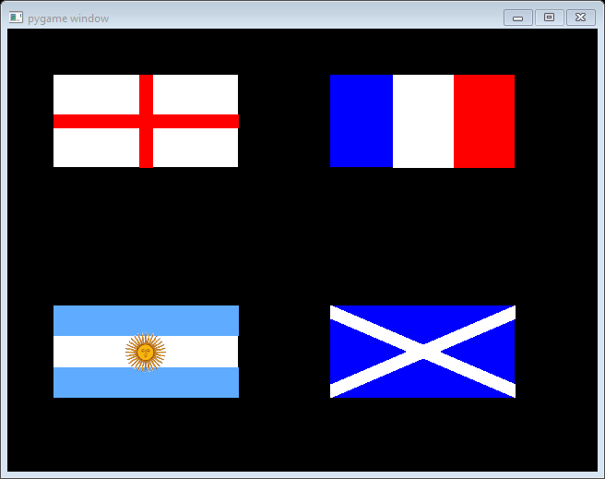

Question 2
More
Pygame Shapes
Draw the French Flag
Marks(2)
Draw the English Flag
Marks(3)
Draw the Scottish Flag
Marks(4)
Extra mark for using variables
Total makes available 15
Draw the flag of Argentina
Marks(5)
Use this image
(right click save as picture)

Slide 6
Put your code here

Slide 7
Put your code here

Slide 8
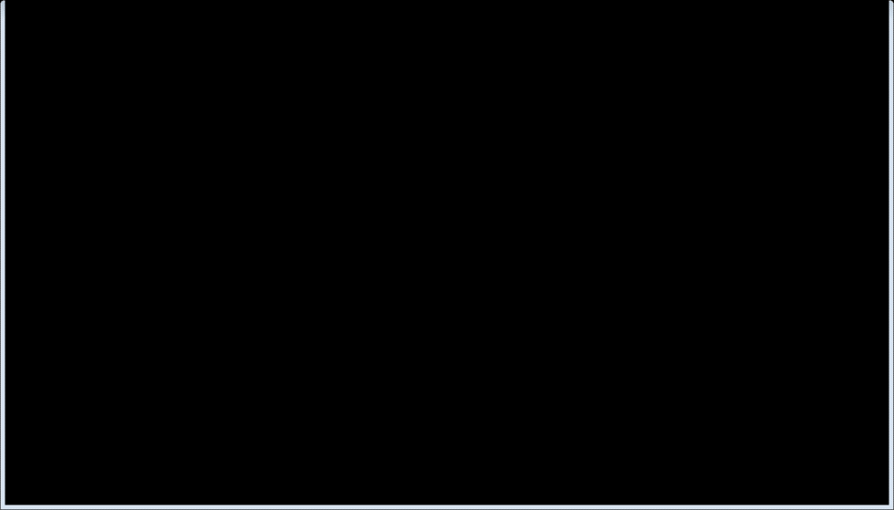

Question 3
More
Pygame Shapes
Make the the sun symbol move left to right across the screen it should bounce of either edge of the screen.
Marks (3)
4 Extra marks for detecting a collision and displaying a count of the number of collisions on the screen
Total makes available 10
Add a second sun symbol that moves up and down it should bounce of either edge of the screen.
Marks (3)

Slide 9
My Code

Slide 10
My Code

Slide 11
My Code

