Slide 1
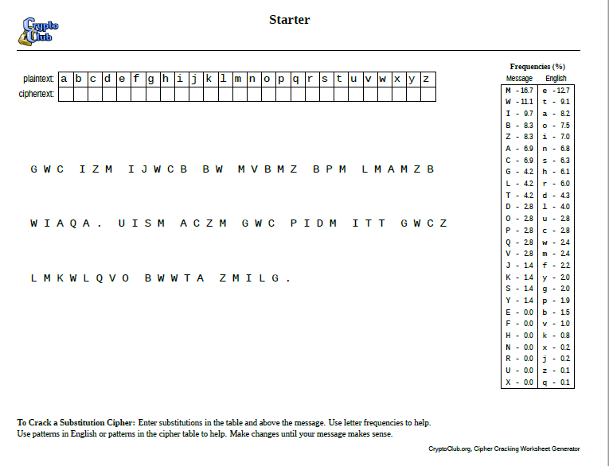

Slide 2
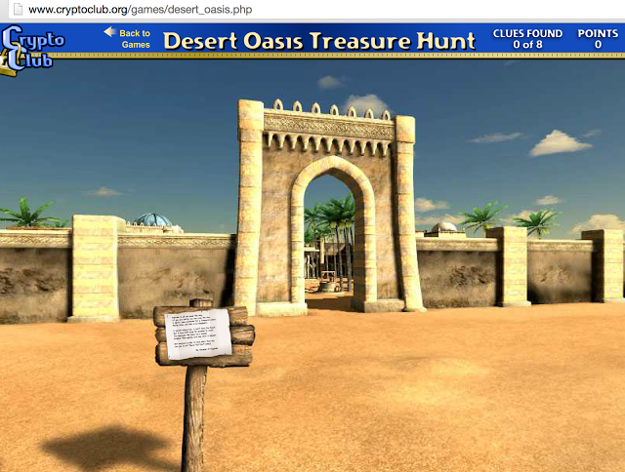
I can explain the importance of ‘Keys’ in cryptography.
I can collaborate with fellow code breakers to crack messages.
I can give practical advice to those wishing to become cryptographers.
Can you complete the Desert Oasis treasure hunt?
Click on the link in Task 3 to find out.

