Slide 1

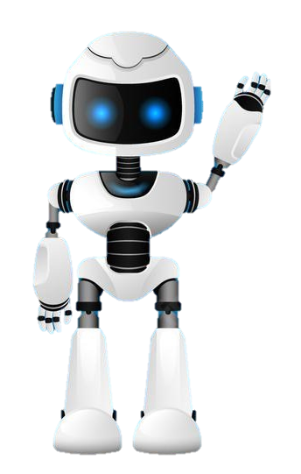

Learning Journal
Unit 1:E-Skills

Slide 2



Lesson 1
Task 1 – Getting Started
Learning Objectives
Start
I can use the python turtle module to draw a basic shape
I can use basic functions in turtle to create and fill simple geometrical shapes
Python
In your own words write down what python turtle helps you to do on a computer.
Learn

Slide 3

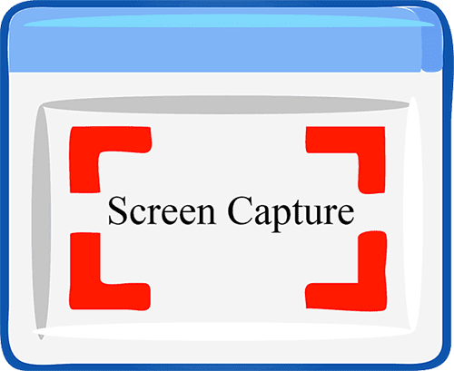
I can use the python turtle module to draw a basic shape
Lesson 1
Task 2 – Introducing Turtle
Put a screen capture of your python code here

Slide 4
I can use the python turtle module to draw a basic shape
Lesson 1
Task 3 – Making Shapes
Put a screen capture of your python code here

Slide 5
I can use the python turtle module to draw a basic shape
Lesson 1
Task 4 – Lets Review it
Put a screen capture of your python code here

Slide 6
I can use the python turtle module to draw a basic shape
Lesson 1
Task 5 – Extension Task
Put a screen capture of your python code here

Slide 7

Lesson 1
Learning Objectives
Complete
How did you do?
Select the appropriate circle. Then go to shape format in the menu and colour it in.
I can use the python turtle module to draw a basic shape
I can use basic functions in turtle to create and fill simple geometrical shapes
Reflect
Write what you have learned today in the box below and anything you are still unsure of.

Slide 8
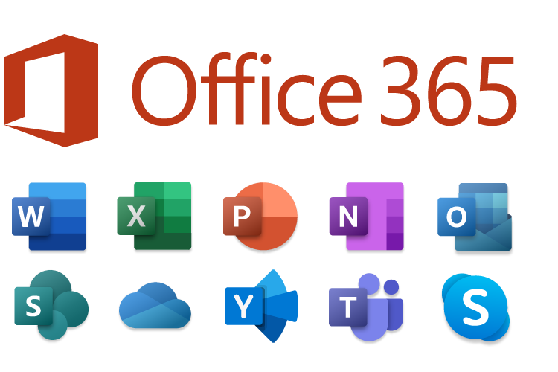
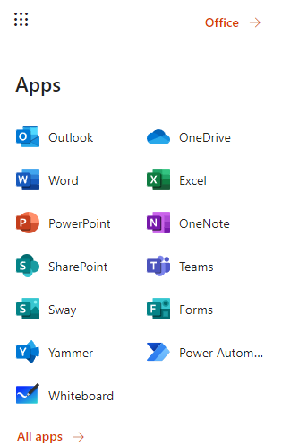
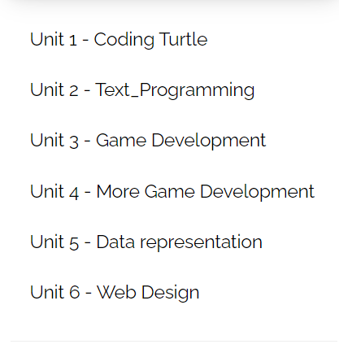
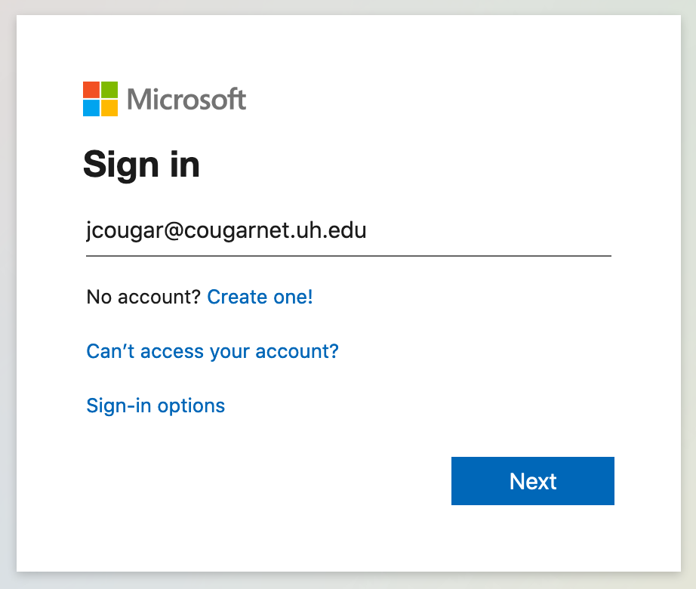
Homework
Task
Inside OneDrive
Create a Year 9 Computer Science folder.
Then inside of that create a folder for each Unit of work.
See below.
username@knoleacademy.org

