Slide 1

Data Representation
Put your name here
Computer Science

Slide 2
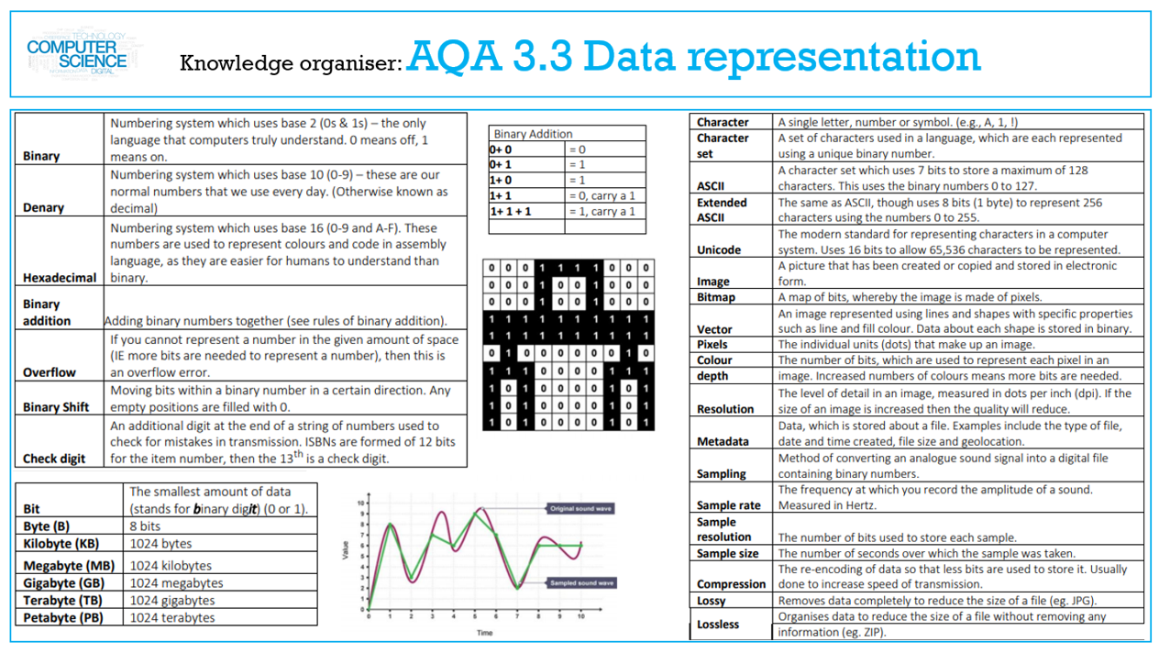

Slide 3
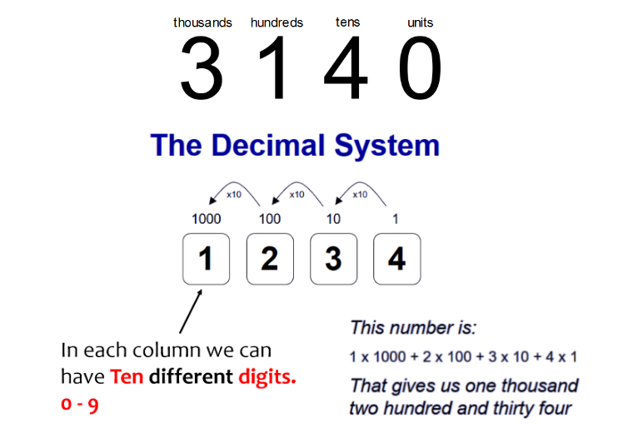
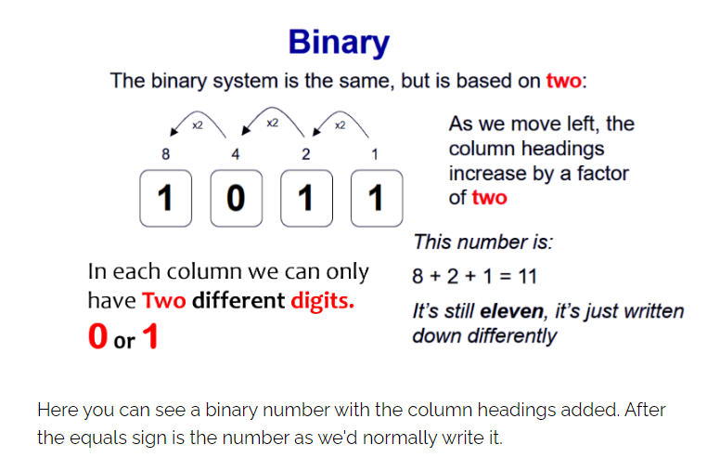
Lesson 1 Number Bases
I need to learn how to understand decimal (base 10)
I need to learn how to understand binary (base 2)
I need to learn how to understand that computers use binary to represent all data and instructions.
I need to learn how to understand how binary can be used to represent whole numbers.

Slide 4
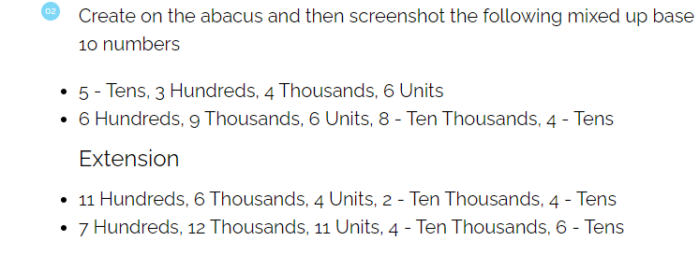
Screenshot your answers Below

Slide 5
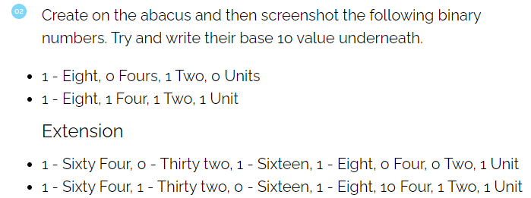
Screenshot your answers Below

Slide 6
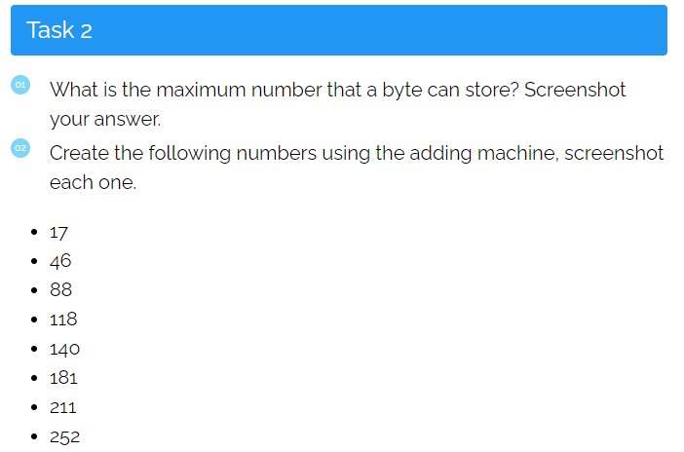
Screenshot your answers Below

Slide 7
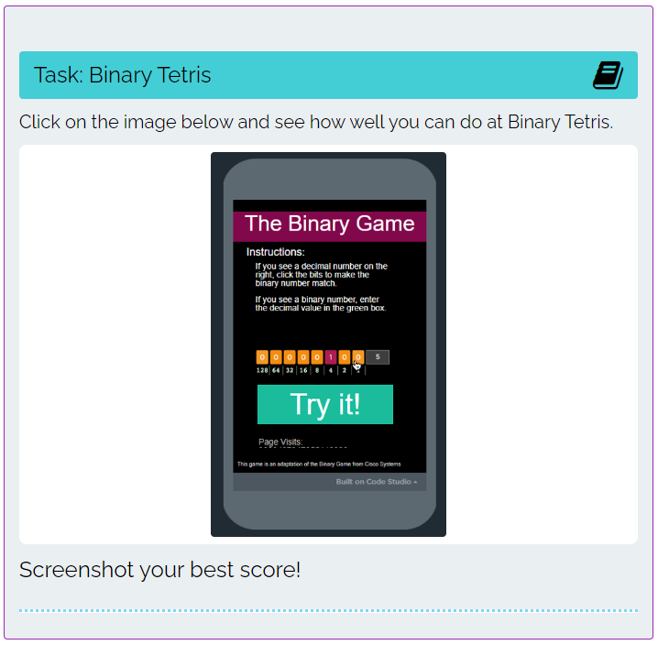
Screenshot your high score Below

Slide 8
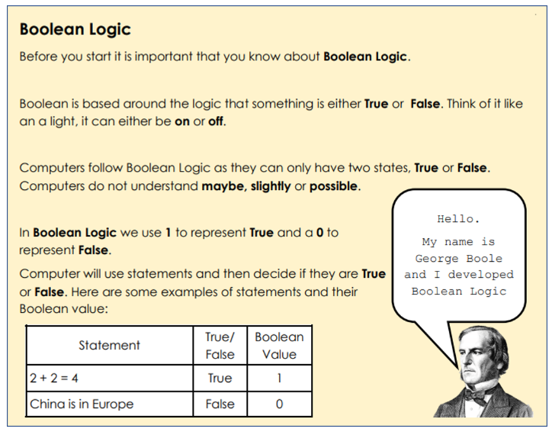
Lesson 2 Boolean Logic
I can explain what logic gates are.
I can use OR gates
I can use AND gates
I can use NOT gates

Slide 9
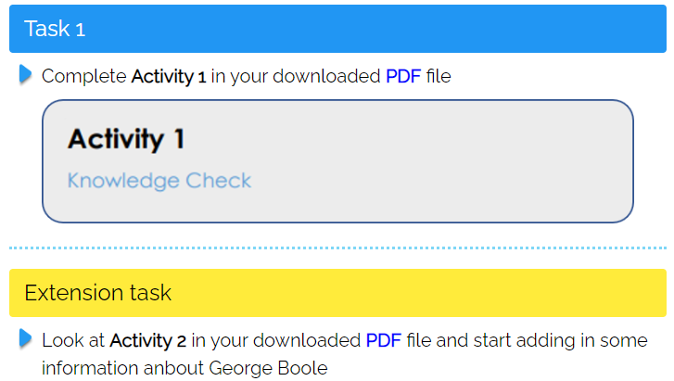
Screenshot your completed PDF pages Below

Slide 10
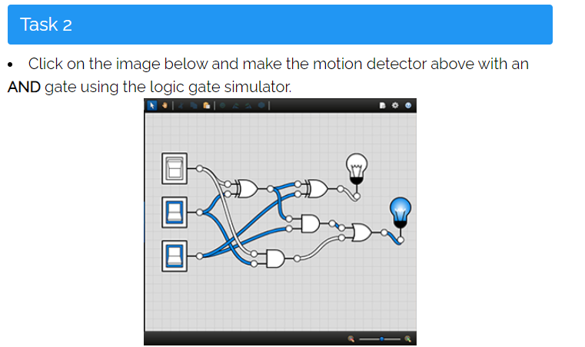
Screenshot your completed Diagram Below

Slide 11
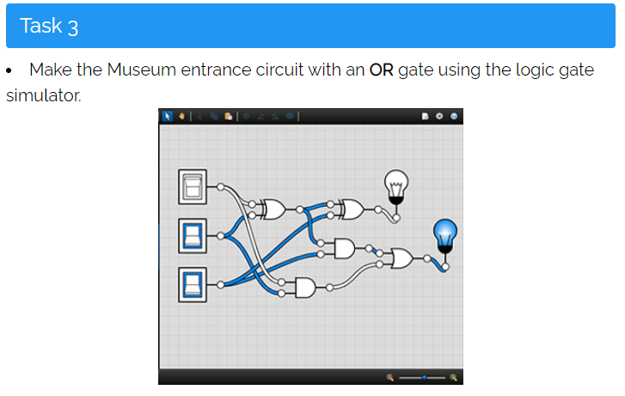
Screenshot your completed Diagram Below

Slide 12
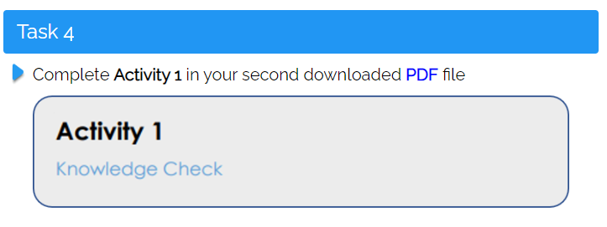
Screenshot your completed PDF pages Below

Slide 13
Screenshot your completed extension Circuits Below

Slide 14
Screenshot your completed extension Circuits Below

Slide 15
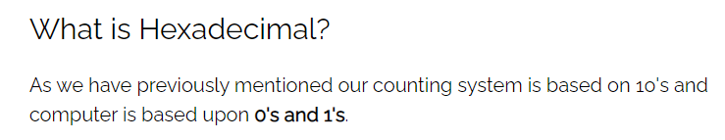
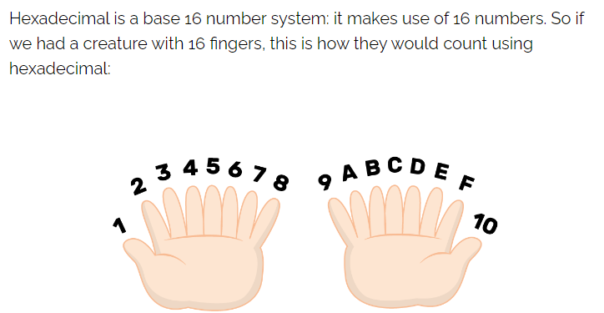
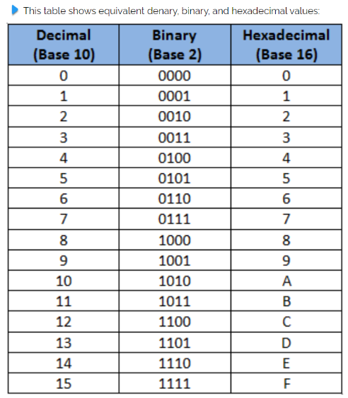
Lesson 3 Number Bases Hex
I need to learn how to understand how hexadecimal can be used to represent whole numbers.
I need to learn how to convert in both directions between binary and hexadecimal.

Slide 16
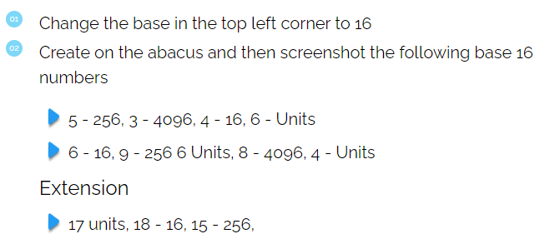
Screenshot your answers Below

Slide 17

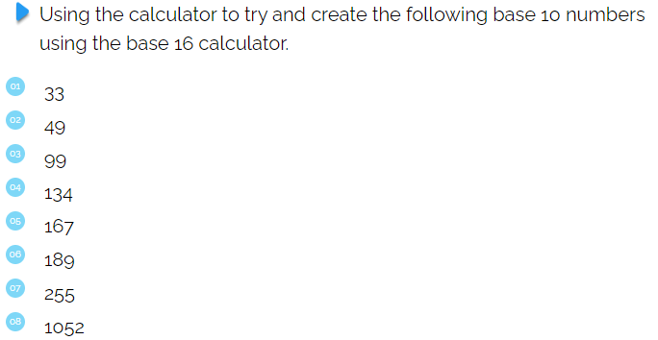
Screenshot your answers Below

Slide 18
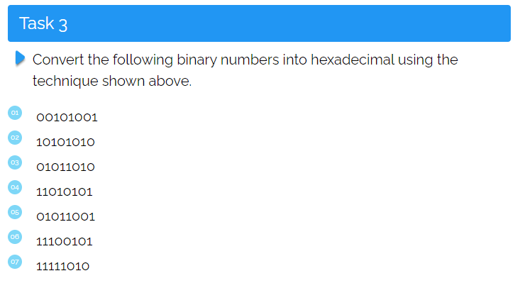
Write your answers Below

Slide 19
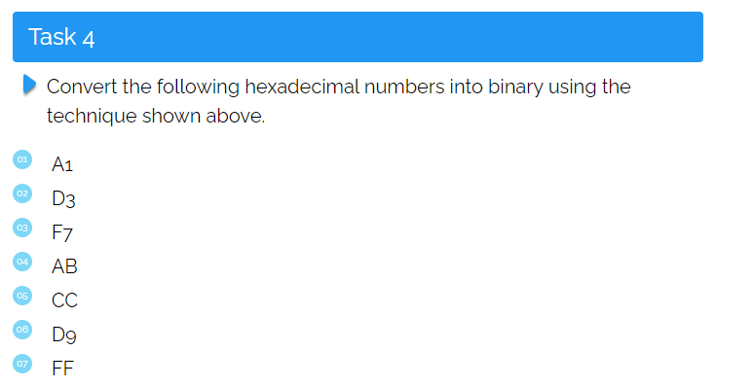
Write your answers Below

Slide 20
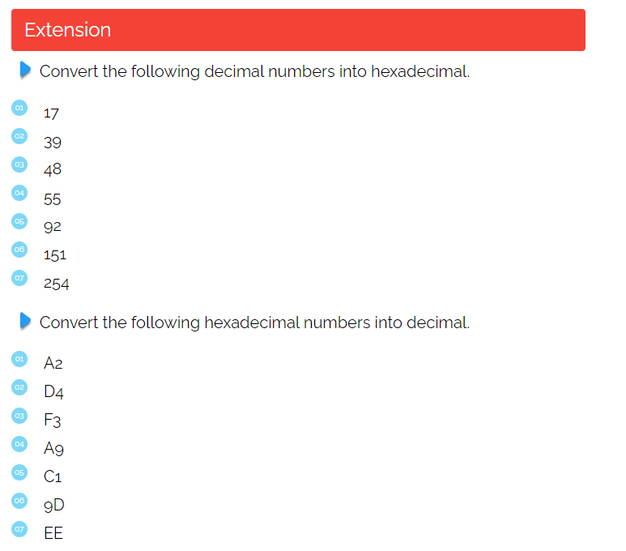
Write your answers Below

Slide 21
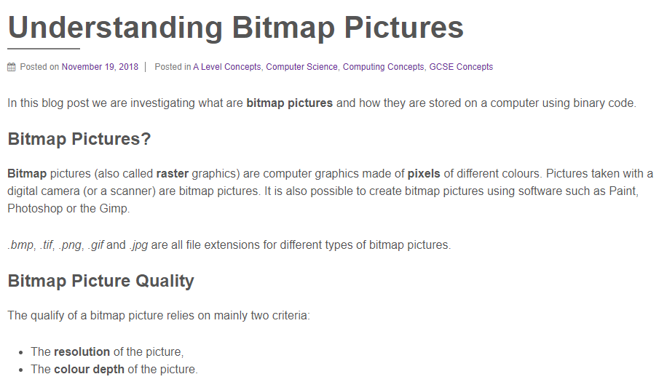
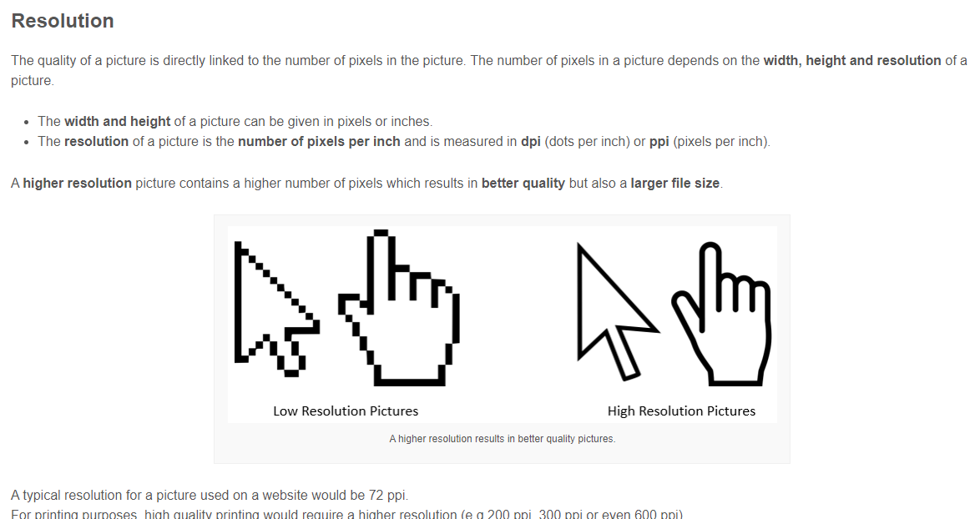
Lesson 4 Computer Graphics
I can explain what a pixel is and how pixels relate to an image and the way images are displayed.
I can describe how the size of a bitmap image in pixels (width x height) is known as the image resolution.
I can explain how the number of pixels and colour depth can affect the file size of a bitmap image.

Slide 22
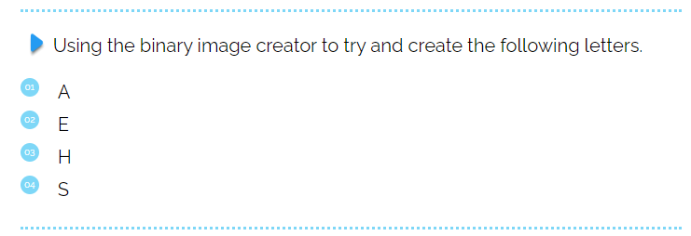
Screenshot your answers Below

Slide 23


Screenshot your image Below

Slide 24
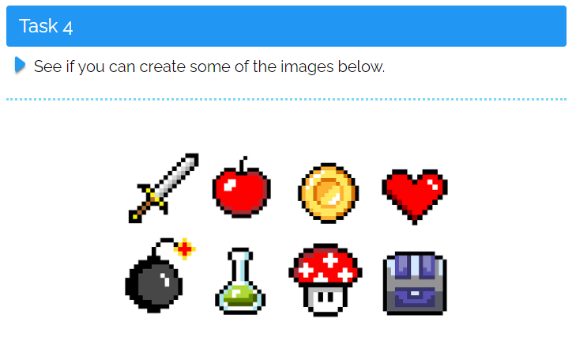
Screenshot your images Below

Slide 25
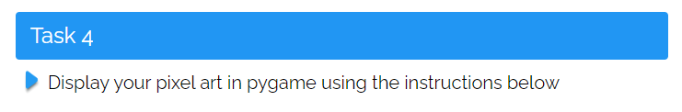
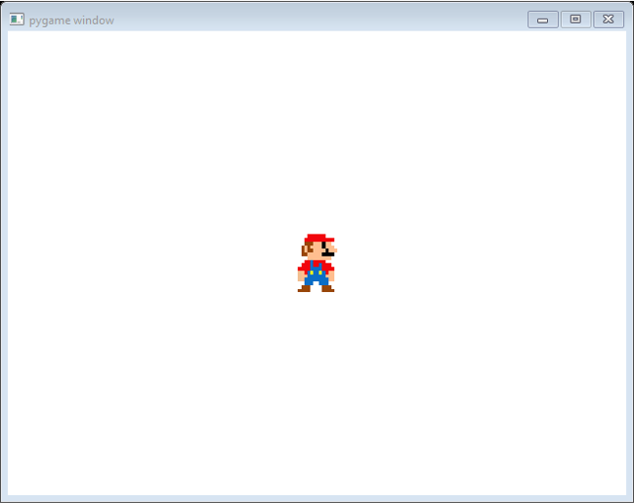
Screenshot your image Below

Slide 26
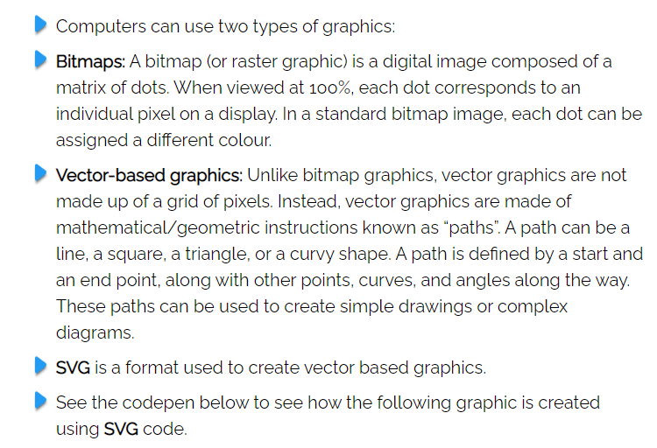
Lesson 5 Bitmaps and Vectors
I need to learn how to explain why hexadecimal is often used in computer science.
I need to learn how to explain the difference between bitmap and vector images

Slide 27
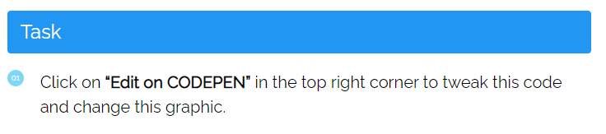
Screenshot your new image Below

Slide 28
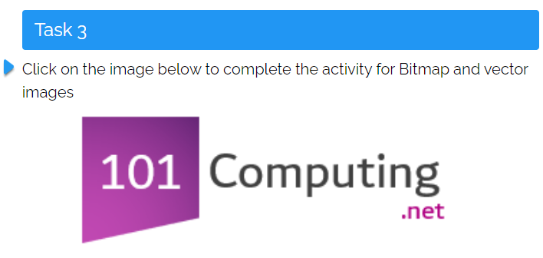
Screenshot your answers below

Slide 29
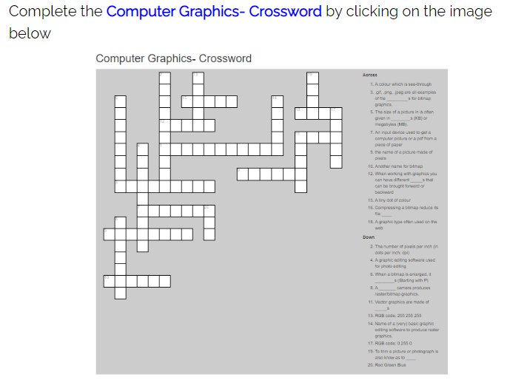
Screenshot your finished puzzle below

Slide 30
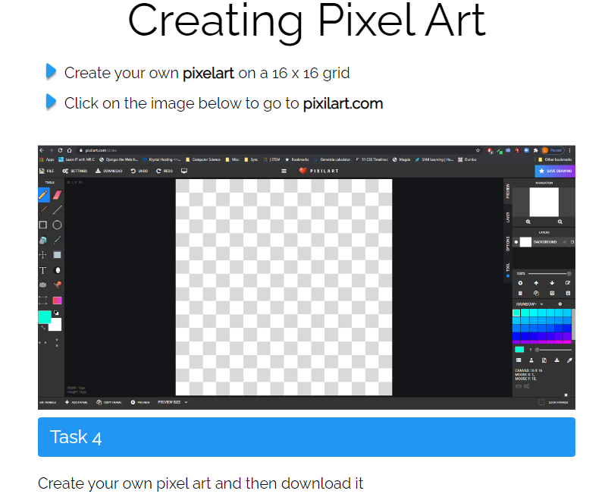
Screenshot your images Below

Slide 31
Screenshot your image Below

