Slide 1

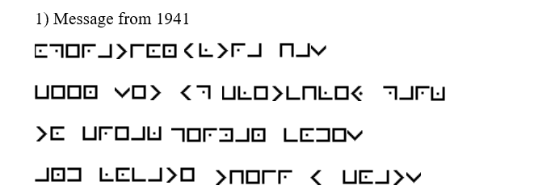
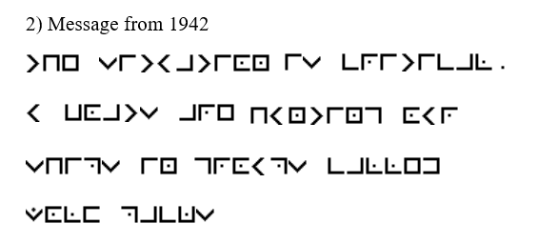
Starter
Can you decode the messages?
Put your decoding here:
Put your decoding here:

Slide 2
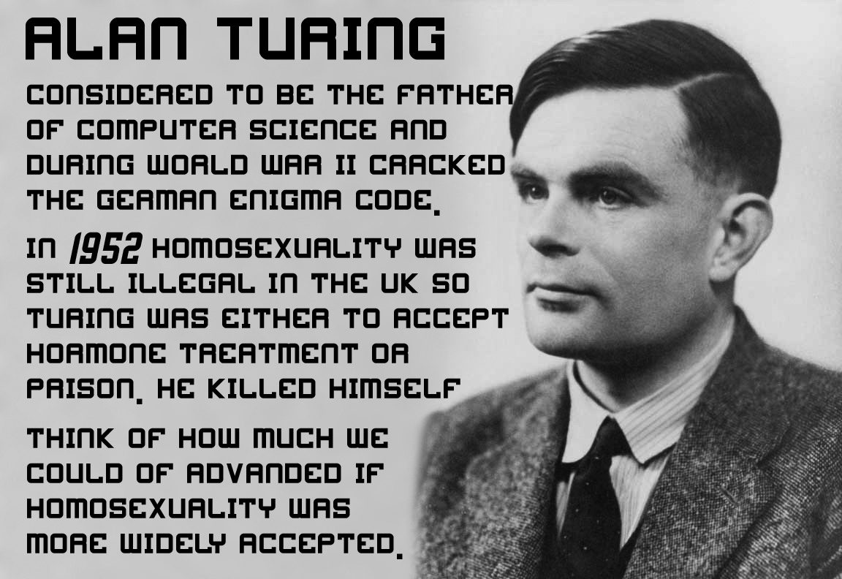
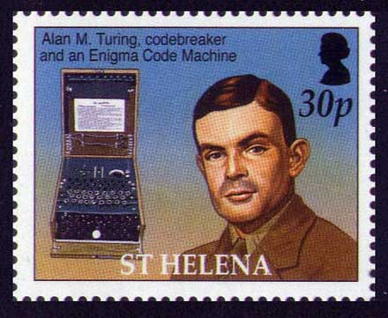
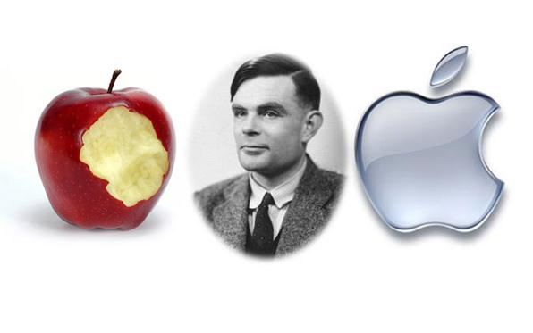
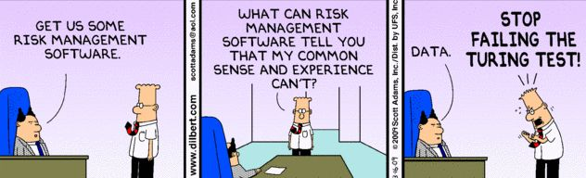
Alan Turing, Computers and WW2
Year 7 term 5 – The history of computing and code breaking

Slide 3
Targets for this lesson
I can describe who Alan Turing was and what he did.
I can recognise the importance of what the Enigma and Bomb machines did.
I can evaluate the importance of artificial intelligence in the present day.

Slide 4
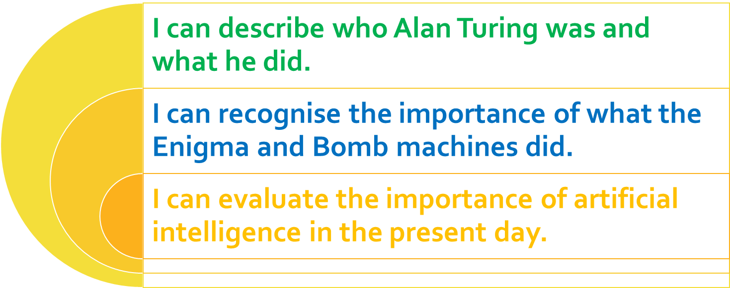
Task 1 – Five Facts
Research and write 5 facts about Alan Turing.
Fact 2:
Fact 4:
Fact 1:
Fact 3:
Fact 5:

Slide 5
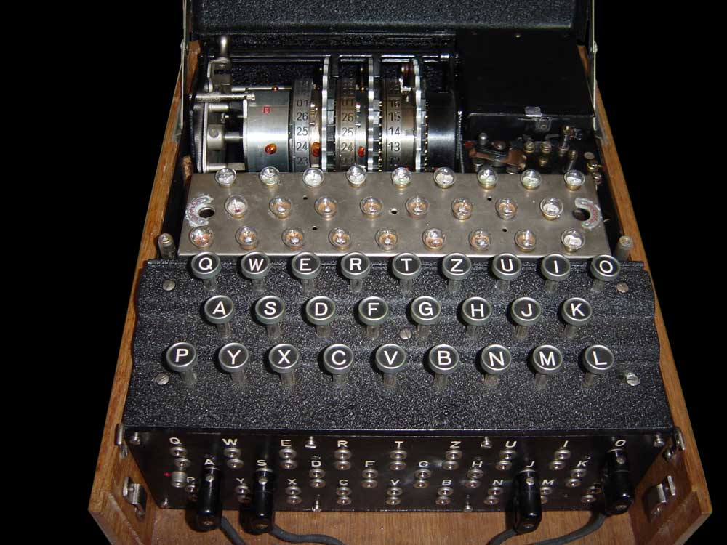
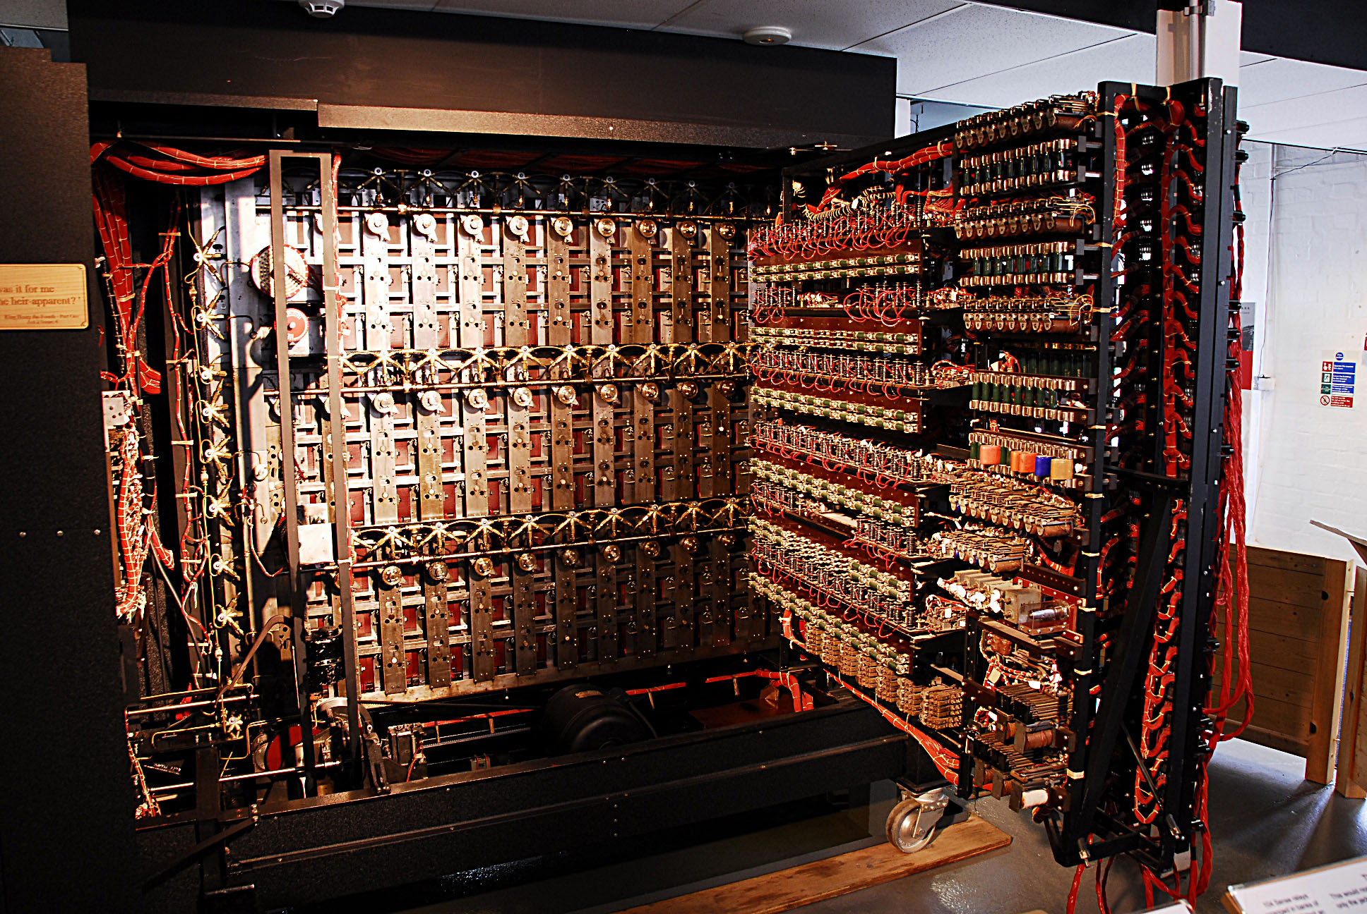
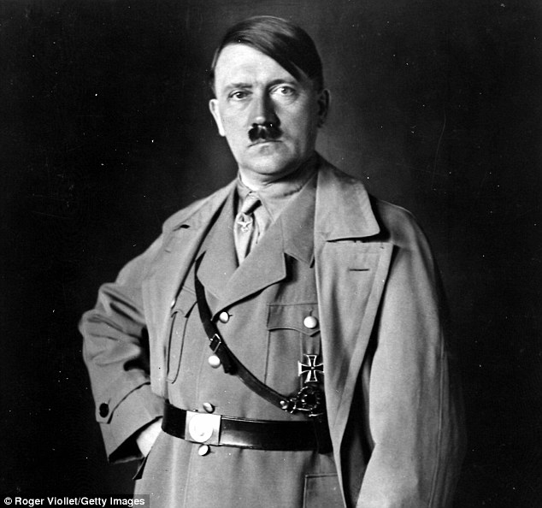

The Enigma and the Bombe!
Research and explain the Enigma machine:
_________________________________________________________________________________________________________________________________________________________________________________________________________________
Research and explain the Bombe machine:
_________________________________________________________________________________________________________________________________________________________________________________________________________________

Slide 6
Talk to an online therapist
I am going to see if Eliza the online therapist can help me.
Would you like to ask Eliza a question?
Do you think Eliza was helpful?
Why?
Talk to her yourself – type the website below into your browser
http://psych.fullerton.edu/mbirnbaum/psych101/eliza.htm
Record some of your questions and Eliza’s answers below.

Slide 7
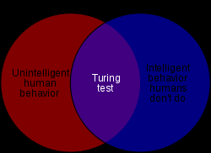

The Turing test
Research and explain what the Turing test is:
_________________________________________________________________________________________________________
Did you pass or fail the Turing test? Why?
_________________________________________________________________________________________________________
What do you think the level of ELIZA’s Artificial Intelligence is?
____________________________________________________________________________

Slide 8
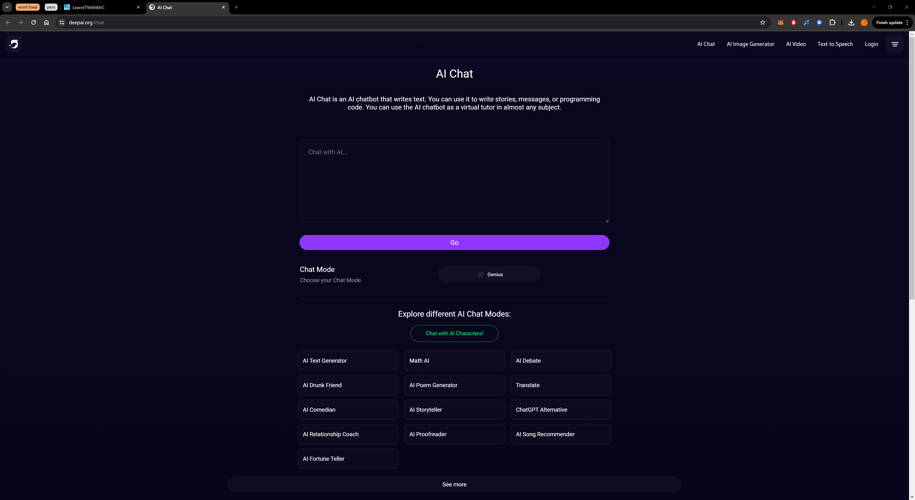
Chat With Deep Ai Does it pass the Turing Test?

Slide 9
Screenshot your conversation with Deep Ai here

Slide 10
Presenting Alan Turing
Open a new, blank PowerPoint presentation.
Create a presentation about Alan Turing.
Include facts about:
Alan Turing’s life
His inventions
His work during World War 2
His work after World War 2
How he died.
You can use this presentation and the internet to help you.
20 minutes.

Slide 11
Answer the following questions.
Who was Alan Turing?
What did Enigma help the Nazis do?
What did Bombe help the British do?
Which machine helped us win WW2?
Who is Eliza?
What is Artificial intelligence?
Why does the Apple logo have a bite taken out of it?
-
-
-
-
-
-
-

Slide 12
Explain how you have met your target grade. Give examples. Choose from the three boxes below based on your target.
Describe what Alan Turing did, below.
Explain the importance of what the Bombe machines did, below.
Evaluate the importance of AI in the present day, below.

